Slide 1
TB-HIV
Last updated: May 2024

Slide 2
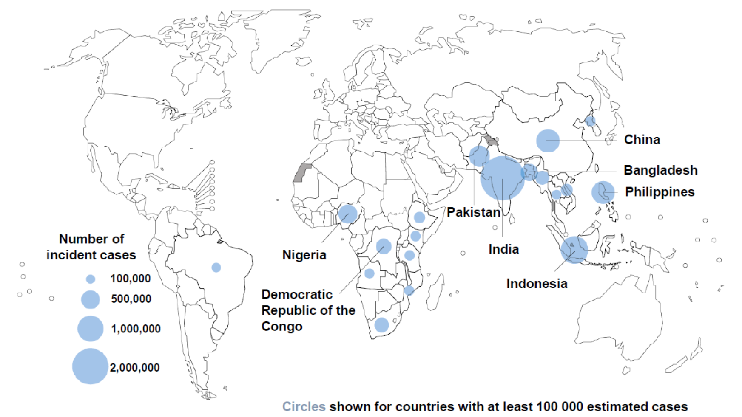
High TB burden countries, Global and Asia and the Pacific, 2022
8 countries accounted for 68% of global TB burden
6 out of those 8 countries are in Asia and the Pacific region
Source: Prepared by www.aidsdatahub.org based on WHO. (2023). Global TB Report 2023

Slide 3
High TB-HIV burden in Asia and the Pacific, 2022
Asia and the Pacific region accounted for:
70%
7.4M
of estimated new TB cases globally
136K
21%
of estimated TB-HIV co-infections globally
736K
66%
of estimated TB mortality globally
Source: Prepared by www.aidsdatahub.org based on WHO. (2023). Global TB Report 2023

Slide 4
Over a third of high TB burden countries are in Asia and the Pacific
30 high TB burden countries
Angola | Bangladesh | Brazil | Central African Republic | China
Congo | DPR Korea | DR Congo | Ethiopia | Gabon
India | Indonesia | Kenya | Lesotho | Liberia
Mongolia | Mozambique | Myanmar | Namibia | Nigeria
Pakistan | Papua New Guinea | Philippines | Sierra Leone | South Africa
Thailand | Uganda | UR Tanzania | Viet Nam | Zambia
Asia and the Pacific
Source: Prepared by www.aidsdatahub.org based on WHO. (2023). Global TB Report 2023

Slide 5
State of the TB-HIV epidemic in Asia and the Pacific
Estimated TB incidence (per 100 000 population)
End TB Target 2030
80% reduction of TB
incidence since 2015
Estimated incidence of TB cases who are HIV-positive (per 100 000 population)
End TB Target 2030
80% reduction of TB
incidence since 2015
TB incidence
2030 End TB target
Source: Prepared by www.aidsdatahub.org based on WHO. (2023). Global TB Report 2023

Slide 6
Close the gap: Unequal progress in integrated TB-HIV testing service among TB patients in Asia and the Pacific countries
75% of 5.2 M notified TB cases accessed HIV testing and knew their status in Asia and the Pacific region
High TB burden countries
Source: Prepared by www.aidsdatahub.org based on WHO. (2023). Global TB Report 2023

Slide 7
undetectable = untransmittable:
Address inequalities and close the gaps along continuum of care cascade in all settings to maximize the benefits of U=U
HIV testing and treatment cascade, Asia and the Pacific, 2022
HIV testing and treatment cascade among PLHIV with TB co-infection, Asia and the Pacific, 2022
1.1 million
1.6 million
1.6 million
51000
61000
5.1 million
4.2 million
4 million
79000
62000
n/a
Source: Prepared by www.aidsdatahub.org based on UNAIDS 2023 HIV Estimates; Global AIDS Monitoring 2023 and WHO. (2023). Global TB Report 2023

Slide 8
Integrate HIV into systems for health: Integrated efforts are needed to close the health service gaps
Proportion of tuberculosis patients living with HIV who are on antiretroviral therapy, 2022
TB patients living with HIV on antiretroviral therapy
TB patients living with HIV NOT on antiretroviral therapy
Source: Prepared by www.aidsdatahub.org based on WHO. (2023). Global TB Report 2023

Slide 9
THANK YOU
slides compiled by www.aidsdatahub.org
Data shown in this slide set are comprehensive to the extent they are available from country reports. Please inform us if you know of sources where more recent data can be used. Please acknowledge www.aidsdatahub.org if slides are lifted directly from this site

