Slide 1
Young Key Populations
Last updated: March 2024

Slide 2
HIV prevalence and epidemiology

Slide 3
HIV and AIDS in Asia and the Pacific, 2022
New HIV
infections
300,000
Among young people (15-24 yr)…
440 000 are living with HIV
78 000 new HIV infections
3 400 died with AIDS-related illness
People living with HIV
6.5 million
Women living with HIV
2.4 million
Young people living with HIV
440,000
In every hour, 9 young people are getting infected with HIV
In every day, 9 young people die with AIDS-related illness
Children living with HIV
130,000
Deaths
150,000
Source: Prepared by www.aidsdatahub.org based on UNAIDS 2023 HIV Estimates

Slide 4
New HIV infections among young people (15-24) in Asia and the Pacific
24%
Decline since 2010
2010
2022
2030
100,000 new HIV infections
78,000 new HIV infections
Target = 90% reduction
from 2010 baseline
Source: Prepared by www.aidsdatahub.org based on UNAIDS 2023 HIV estimates

Slide 5
New HIV infections and AIDS-related deaths among young people in Asia Pacific, 2000–2022
24% decline in new HIV infections
51% decline in AIDS-related deaths
between 2010 and 2022
2030 target is equivalent to a 90% reduction since 2010
Source: Prepared by www.aidsdatahub.org based on UNAIDS 2023 HIV Estimates

Slide 6
Distribution of new HIV infections by age, Asia and the Pacific, 2022
10%
4%
26%
300 000
of new HIV infections in Asia and the Pacific
60%
0-14 yr
15-24 yr
25-49 yr
50+ yr
Source: Prepared by www.aidsdatahub.org based on UNAIDS 2023 HIV Estimates

Slide 7
HIV and AIDS among young people (15-24 yr) in Asia and the Pacific 2000-2022
2022 “zoom-in”
78,000
New HIV infections
440,000
Young people living with HIV
3400
AIDS-related deaths
Young men
Young women
Source: Prepared by www.aidsdatahub.org based on UNAIDS 2023 HIV Estimates

Slide 8
New HIV infections trends diverse greatly in Asia and the Pacific countries
Percentage change in new HIV infections among young people (15-24 yr) by country, 2010-2022
* <500 new HIV infections in 2022;
Bhutan, Fiji, Maldives, Mongolia, New Zealand Sri Lanka and Timor-Leste have <50 new HIV infections in 2022
Source: Prepared by www.aidsdatahub.org based on UNAIDS 2023 HIV Estimates

Slide 9
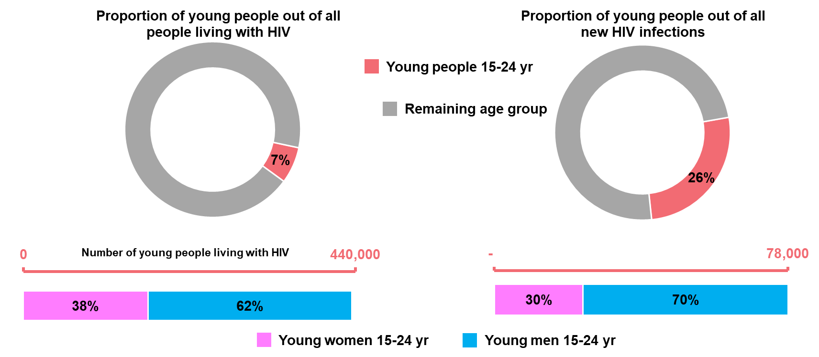
Snapshot of young people and HIV infections in Asia and the Pacific, 2022
Number of new infections among young people
Source: Prepared by www.aidsdatahub.org based on UNAIDS 2023 HIV Estimates

Slide 10
440,000 young people (15-24) were living with HIV in 2022, 7% of people living with HIV in Asia and the Pacific
Young people living with HIV, 1990 - 2022
320,000 young female (15-24)
370,000 young male (15-24)
Source: Prepared by www.aidsdatahub.org based on UNAIDS 2023 HIV Estimates

Slide 11
Countries where HIV prevalence among young key populations (15-24 yr) is ≥5%, 2015-2022
* TG sample size less than 50; ** MSM age bracket is 20-24; *** TG data for Hanoi
Source: Prepared by www.aidsdatahub.org based on Global AIDS Monitoring Reporting 2023; HIV Sentinel Surveillance Surveys and Integrated Biological and Behavioural Surveys

Slide 12
HIV prevalence among sex workers by age group, countries where data is available, 2016-2022
Source: Prepared by www.aidsdatahub.org based on Behavioural Surveys; Integrated Biological and Behavioural Surveys; and Global AIDS Monitoring (GAM) reporting

Slide 13
HIV prevalence among men who have sex with men by age group, countries where data is available, 2015-2022
* Kathmandu
Source: Prepared by www.aidsdatahub.org based on Behavioural Surveys; Integrated Biological and Behavioural Surveys; Global AIDS Response Progress Reporting; Global AIDS Monitoring (GAM) reporting

Slide 14
HIV prevalence among transgender people by age group, countries where data is available, 2015 - 2022
Source: Prepared by www.aidsdatahub.org based on Behavioural Surveys; Integrated Biological and Behavioural Surveys; and Global AIDS Monitoring (GAM) reporting

Slide 15
HIV prevalence among people who inject drugs by age group, countries where data is available, 2015 - 2022
Source: Prepared by www.aidsdatahub.org based on Behavioural Surveys; Integrated Biological and Behavioural Surveys; and Global AIDS Monitoring (GAM) reporting

Slide 16
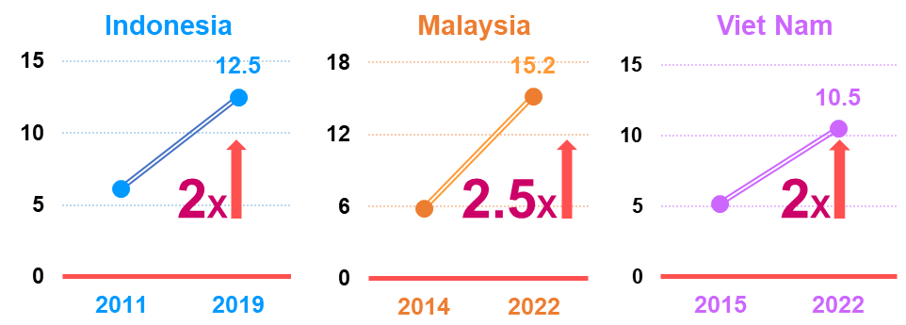
Rising HIV infections among young MSM (15-24 years), select countries where trend data are available, 2011-2022
Source: Prepared by www.aidsdatahub.org based on Integrated Biological and Behavioural Surveys, and UNAIDS 2023 HIV Estimates

Slide 17
HIV incidence among young MSM in urban areas
High incidence in urban areas, younger MSM
Association: low HIV knowledge and syphilis infection
Association: younger age, drug use for sexual pleasure, inconsistent condom use, receptive anal intercourse, group sex, herpes and syphilis infection
Source: Prepared by www.aidsdatahub.org based on Dong Z, Xu J, Zhang H, Dou Z, Mi G, et al. (2014) HIV Incidence and Risk Factors in Chinese Young Men Who Have Sex with Men—A Prospective Cohort Study. PLoS ONE 9(5); van Griensven, F., Thienkrua, W., McNicholl, J., et al. (2013). Evidence of an explosive epidemic of HIV infection in a cohort of men who have sex with men in Thailand. AIDS, 27(5), 825-832.

Slide 18
Risk behaviours

Slide 19
Age of entry into risk behaviors among key populations
11% of PWID in India started injecting at age younger than 18 years
52% of PWID in India started injecting at age 18-24 years
6% of MSM in India engaged first commercial sex with male at the age younger than 15 years
Hijras and MSWs in Pakistan entered sex work at mean age of 16 years
Mean age PWID started injecting drugs in Myanmar*, Pakistan, Philippines*, and
Viet Nam* is 20-26 years
47% of PWID in Nepal started injecting at age younger than 20 years
10 – 14 years
15 – 19 years
20 – 24 years
≥ 25 years
13-23% of transgender women who ever sold sex in Cambodia and Nepal entered sex work at the age younger than 15 years
FSWs entered sex work in Lao PDR, Maldives, Philippines and PNG at a median age of 17-20 years
FSWs entered sex work in Cambodia, Malaysia, Myanmar**, Pakistan Thailand* and
Viet Nam* at the mean age of 22-24 years
10% of FSWs surveyed in India entered sex work at age younger than 18 years
*median; **Mandalay
Source: Prepared by www.aidsdatahub.org based on Behavioural Surveys and Integrated Biological and Behavioural Surveys

Slide 20
Condom use at last sex among sex workers by age group, countries where data are available, 2016-2022
* FSW, MSW and TG SW
Source: Prepared by www.aidsdatahub.org based on Behavioural Surveys; Integrated Biological and Behavioural Surveys; and Global AIDS Monitoring (GAM) reporting

Slide 21
Condom use at last anal sex among MSM by age group, countries where data are available, 2014-2022
* age-disaggregated data is not available from the most recent IBBS
** Kathmandu, during last commercial sex, very small sample size (<50) for young MSM
Source: Prepared by www.aidsdatahub.org based on Behavioural Surveys; Integrated Biological and Behavioural Surveys; and Global AIDS Monitoring (GAM) reporting

Slide 22
Condom use at last sex among transgender people by age group, countries where data are available, 2016-2022
* very small sample size (about 50 or less) for young TG
Source: Prepared by www.aidsdatahub.org based on Behavioural Surveys; Integrated Biological and Behavioural Surveys; and Global AIDS Monitoring (GAM) reporting

Slide 23
Condom use at last sex among PWID by age group, countries where data are available, 2015-2022
* very small sample size (about 50 or less) for young PWID
Source: Prepared by www.aidsdatahub.org based on Behavioural Surveys; Integrated Biological and Behavioural Surveys; and Global AIDS Monitoring (GAM) reporting

Slide 24
Proportion of PWID reported using sterile injection equipment at last injection by age group, countries where data are available, 2015-2022
* very small sample size (<50) for young PWID
Source: Prepared by www.aidsdatahub.org based on Behavioural Surveys; Integrated Biological and Behavioural Surveys; and Global AIDS Monitoring (GAM) reporting

Slide 25
Vulnerability and HIV knowledge

Slide 26
Proportion of key populations with comprehensive HIV knowledge, by age group, countries where data are available, 2014 - 2020
* age group 18-19 yr versus 20+ yr; ** age group 20-24 yr; Indonesia – direct female sex workers
Source: Prepared by www.aidsdatahub.org based on 1) Integrated Biological and Behavioral Surveys ; 2. Behavioral Surveillance Surveys and 3) Global AIDS Monitoring Reporting

Slide 27
National response

Slide 28
HIV Prevention coverage among young sex workers (15-24 years), 2018-2022
Source: Prepared by www.aidsdatahub.org based on 1) Integrated Biological and Behavioral Surveys ; 2. Behavioral Surveillance Surveys and 3) Global AIDS Monitoring Reporting

Slide 29
HIV Prevention coverage among young men who have sex with men (15-24 years), 2018-2022
Source: Prepared by www.aidsdatahub.org based on 1) Integrated Biological and Behavioral Surveys ; 2. Behavioral Surveillance Surveys and 3) Global AIDS Monitoring Reporting

Slide 30
HIV Prevention coverage among young transgender (15-24 years), 2018-2022
Source: Prepared by www.aidsdatahub.org based on 1) Integrated Biological and Behavioral Surveys ; 2. Behavioral Surveillance Surveys and 3) Global AIDS Monitoring Reporting

Slide 31
HIV Prevention coverage among young people who inject drugs (15-24 years), 2018-2022
Source: Prepared by www.aidsdatahub.org based on 1) Integrated Biological and Behavioral Surveys ; 2. Behavioral Surveillance Surveys and 3) Global AIDS Monitoring Reporting

Slide 32
People receiving PrEP by age group, select countries, 2021-2022
Source: UNAIDS Global AIDS Reporting 2023

Slide 33
Proportion of sex workers who know their HIV status, 2019 - 2022
Source: Prepared by www.aidsdatahub.org based on 1) Integrated Biological and Behavioral Surveys ; 2. Behavioral Surveillance Surveys and 3) Global AIDS Monitoring Reporting

Slide 34
Proportion of men who have sex with men who know their HIV status, 2016 - 2022
Source: Prepared by www.aidsdatahub.org based on 1) Integrated Biological and Behavioral Surveys ; 2. Behavioral Surveillance Surveys and 3) Global AIDS Monitoring Reporting

Slide 35
Proportion of transgender who know their HIV status, 2017 - 2022
Source: Prepared by www.aidsdatahub.org based on 1) Integrated Biological and Behavioral Surveys ; 2. Behavioral Surveillance Surveys and 3) Global AIDS Monitoring Reporting

Slide 36
Proportion of young PWID who know their HIV status, 2016 - 2022
Source: Prepared by www.aidsdatahub.org based on 1) Integrated Biological and Behavioral Surveys ; 2. Behavioral Surveillance Surveys and 3) Global AIDS Monitoring Reporting

Slide 37
THANK YOU
slides compiled by www.aidsdatahub.org
Data shown in this slide set are comprehensive to the extent they are available from country reports. Please inform us if you know of sources where more recent data can be used. Please acknowledge www.aidsdatahub.org if slides are lifted directly from this site

