Slide 1
Mongolia
Last updated: February 2024

Slide 2
CONTENT
Basic socio-demographic indicators
HIV prevalence and epidemiological status
Risk behaviors
Vulnerability and HIV knowledge
HIV expenditure
National response

Slide 3
BASIC SOCIO-DEMOGRAPHIC INDICATORS
Total population (in thousands) | 2,959 (2015) ¹
Population aged 15-49 (thousands) | 1,672 (2015) ¹
Maternal mortality ratio (per 100 000 live births) | 44 (2015) ⁵
Percentage of population in urban areas | 72 (2015) ²
Antenatal care coverage - At least one visit (%) | 98.7 (2013) ⁷
Crude birth rate (births per 1,000 population) | 23.9 (2014) ²
Under-5 mortality rate (per 1,000 live births) | 22 (2015) ²
Human development index (HDI) - Rank/Value | 90/0.727 (2014) ⁴
Life expectancy at birth (years) - Male/Female | 65/73 (2015) ⁵
Adult literacy rate (%) | 98 (2010) ²
Ratio of girls to boys enrolled at primary level in public and private school (%) | 0.98 (2014) ²
GDP per capita (PPP, current international $) | 12,189 (2015) ²
Per capita total expenditure on health (PPP int. $) | 530 (2012) ³
Sources: Prepared by www.aidsdatahub.org based on 1. UN Population Division. (2015). World Population Prospects: The 2015 Revision - Extended Dataset; 2. World Bank. World Data Bank: World Development Indicators & Global Development Finance. Retrieved July 2016, from http://data.worldbank.org/; 3. WHO. (2015). World Health Statistics 2015; 4. Palanivel, T., Mirza, T., Tiwari, B. N., Standley, S., & Nigam, A. (2016). Asia-Pacific Human Development Report - Shaping the Future: How Changing Demographics Can Power Human Development; 5. WHO. (2016). World Health Statistics 2016: Monitoring health for the SDGs; 6. World Bank Group. (2016). World Development Indicators 2016 and 7. UNSD. Millennium Development Goals Database - Antenatal Care Coverage Retrieved May 2016, from http://data.un.org/Data.aspx?q=Antenatal+care+coverage&d=MDG&f=seriesRowID%3a762.

Slide 4
HIV prevalence and epidemiology

Slide 5
Estimated people living with HIV, new HIV infections and AIDS-related deaths, 1990-2022
Source: Prepared by www.aidsdatahub.org based on UNAIDS HIV estimates 2023

Slide 6
Estimated number of adults (15+) living with HIV and women (15+) living with HIV, 1990-2022
Source: Prepared by www.aidsdatahub.org based on UNAIDS HIV estimates 2023

Slide 7
Key population size estimates, 2021-2022
Key population size estimates
Populations | Estimate | Year of estimate
Female sex workers (FSW) | 7333 | 2022
Men who have sex with men (MSM) | 7481 | 2022
Transgender (TG) (Ulaanbaatar) | 800 | 2021
Source: Prepared by www.aidsdatahub.org based on Global AIDS Monitoring and National Center for Communicable Diseases, Mongolia (2023). Population size estimation of female sex workers and men who have sex with men in Mongolia, 2022

Slide 8
HIV prevalence among key populations, 2022
TRANSGENDER PEOPLE
(2022)
MEN WHO HAVE SEX
WITH MEN (2022)
PEOPLE WHO
INJECT DRUGS
FEMALE
SEX WORKERS (2022)
Source: Prepared by www.aidsdatahub.org based on Serological surveys and Global AIDS Monitoring

Slide 9
HIV prevalence among key populations, 2007-2022
2012 & 2014 surveys in used a different methodology and data should be interpreted with caution when the results are compared with earlier rounds
Source: Prepared by www.aidsdatahub.org based on 1) Second Generation HIV and STI Surveillance Report s; 2) HIV/STI Surveillance Survey 2014 cited in Mongolia Global AIDS Response Progress Report 2015 (Country Narrative Report); 3 Global AIDS Monitoring (GAM) and 4) IBBS 2019, 2021 and 2022

Slide 10
Syphilis prevalence among key populations and other surveyed populations, 2009-2022
Source: Prepared by www.aidsdatahub.org based on 1) Global HIV/AIDS Response - Epidemic Update and Health Sector Progress Towards Universal Access - Progress Report, 2011; 2) Second Generation Surveillance Surveys cited in Mongolia Global AIDS Response Progress Report 2015 (Country Narrative Report); and IBBS 2022

Slide 11
Syphilis prevalence among female sex workers and men who have sex with men by survey location, 2022
Source: Prepared by www.aidsdatahub.org based on National Center for Communicable Diseases, Mongolia (2022). Integrated biological and behavioral survey among high-risk population in Mongolia, 2022

Slide 12
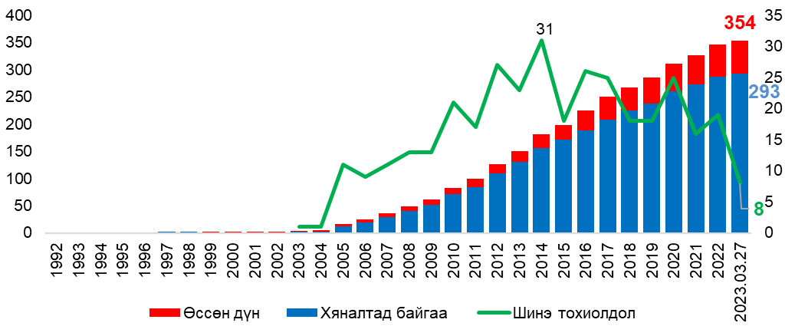
Annual and cumulative reported HIV cases, 1992 – Mar 2023
HIV cases
AIDS cases
Annual HIV cases
Source: Prepared by www.aidsdatahub.org based National Center for Communicable Diseases, Mongolia (2023). Dr J Davaakham - The current situation of STI and HIV/AIDS in Mongolia

Slide 13
Cumulative HIV cases among males by population, 2023
309
of cumulative reported HIV cases
Source: Prepared by www.aidsdatahub.org based National Center for Communicable Diseases, Mongolia (2023). Dr J Davaakham - The current situation of STI and HIV/AIDS in Mongolia

Slide 14
Reported STI cases, 2013 – 2023
Source: Prepared by www.aidsdatahub.org based National Center for Communicable Diseases, Mongolia (2023). Dr J Davaakham - The current situation of STI and HIV/AIDS in Mongolia

Slide 15
Risk behaviours

Slide 16
Trends in condom use at last sex among key populations, 2007-2022
Source: Prepared by www.aidsdatahub.org based on 1) Ministry of Health and NCCD. (2012). Second Generation HIV and STI surveillance Report, 2012. Mongolia; 2) Mongolia Global AIDS Response Progress Report 2015 (Country Narrative Report); 3) Global AIDS Monitoring (GAM) and 4) National Center for Communicable Diseases, Mongolia (2022). Integrated biological and behavioral survey among high-risk population in Mongolia, 2022

Slide 17
Proportion of female sex workers who reported condom use with their clients, 2022
Source: Prepared by www.aidsdatahub.org based on National Center for Communicable Diseases, Mongolia (2022). Integrated biological and behavioral survey among high-risk population in Mongolia, 2022

Slide 18
Proportion of men who have sex with men who reported condom use at last sex by partner type, 2022
Source: Prepared by www.aidsdatahub.org based on National Center for Communicable Diseases, Mongolia (2022). Integrated biological and behavioral survey among high-risk population in Mongolia, 2022

Slide 19
Proportion of men who have sex with men who reported consistent condom use in the last 12 months by partner type, 2022
Source: Prepared by www.aidsdatahub.org based on National Center for Communicable Diseases, Mongolia (2022). Integrated biological and behavioral survey among high-risk population in Mongolia, 2022

Slide 20
Proportion of transgender women who reported condom use at last sex by partner type, 2022
Source: Prepared by www.aidsdatahub.org based on National Center for Communicable Diseases, Mongolia (2022). Integrated biological and behavioral survey among high-risk population in Mongolia, 2022

Slide 21
Proportion of transgender women who reported consistent condom use in the last 12 months by partner type, 2022
Source: Prepared by www.aidsdatahub.org based on National Center for Communicable Diseases, Mongolia (2022). Integrated biological and behavioral survey among high-risk population in Mongolia, 2022

Slide 22
Vulnerability and HIV knowledge

Slide 23
Proportion of key populations, mobile men and male STI patients with comprehensive HIV knowledge, 2005-2022
Source: Prepared by www.aidsdatahub.org based on 1. Ministry of Health Mongolia, WHO, et al. (2008). Second Generation HIV/STI Surveillance Report, 2007 Mongolia. 2. Preliminary Data from Second Generation Sentinel Surveillance 2009 cited in National Committee on HIV/AIDS. (2010). UNGASS Country Progress Report: Mongolia; 3. Ministry of Health and NCCD. (2012). Second Generation HIV and STI surveillance Report 2012; and 4 National Center for Communicable Diseases, Mongolia (2022). Integrated biological and behavioral survey among high-risk population in Mongolia, 2022

Slide 24
Proportion of key populations who have heard about PrEP, 2022
Source: Prepared by www.aidsdatahub.org based on National Center for Communicable Diseases, Mongolia (2022). Integrated biological and behavioral survey among high-risk population in Mongolia, 2022

Slide 25
Key populations who avoided seeking healthcare in the last 12 months due to fear of stigma and discrimination, 2022
Source: Prepared by www.aidsdatahub.org based on National Center for Communicable Diseases, Mongolia (2022). Integrated biological and behavioral survey among high-risk population in Mongolia, 2022

Slide 26
HIV expenditure

Slide 27
AIDS financing, 2021
AIDS spending by financing source
AIDS spending by service category
Domestic funding
48%
2.5
million US$
Key populations prevention
25%
Other prevention
4%
International funding
52%
Care and treatment
40%
Source: Prepared by www.aidsdatahub.org based on UNAIDS HIV Financial Dashboard

Slide 28
AIDS spending by financing source, 2007 - 2021
Source: Prepared by www.aidsdatahub.org based on UNAIDS HIV Financial Dashboard and NASA 2017-2021

Slide 29
HIV spending in Mongolia by AIDS Spending Category in 2017-2021
Source: Prepared by www.aidsdatahub.org based on NASA 2017-2021

Slide 30
HIV expenditure by spending category and financing source, 2021
Source: Prepared by www.aidsdatahub.org based on NASA 2017-2021

Slide 31
National response

Slide 32
Proportion of female sex workers and men who have sex with men reached with HIV prevention programmes, 2005-2022
Source: Prepared by www.aidsdatahub.org based on Second Generation Surveillance Reports 2005-2014 cited in Mongolia Global AIDS Response Progress Reporting 2015 (Country Narrative Report), Global AIDS Monitoring Reporting and IBBS 2019 and 2022

Slide 33
Proportion of key populations reached with HIV prevention programmes, 2022
Source: Prepared by www.aidsdatahub.org based on National Center for Communicable Diseases, Mongolia (2022). Integrated biological and behavioral survey among high-risk population in Mongolia, 2022

Slide 34
Proportion of key populations who received an HIV test in the last 12 months and know their results, 2009-2022
Source: Prepared by www.aidsdatahub.org based on Second Generation Surveillance Reports 2005-2014 cited in Mongolia Global AIDS Response Progress Reporting 2015 (Country Narrative Report), Global AIDS Monitoring Reporting and IBBS 2019 and 2022

Slide 35
Annual number of people on ART, 2005-2022
Source: Prepared by www.aidsdatahub.org based on UNAIDS HIV Estimates 2023

Slide 36
ART scale-up, 2000 - 2022
Source: Prepared by www.aidsdatahub.org based on UNAIDS HIV estimates 2023

Slide 37
Treatment cascade, 2022
* Number of people on ART who received a viral load test in the past year and have viral load of <1000 copies/ml
Source: Prepared by www.aidsdatahub.org based on UNAIDS HIV estimates 2023

Slide 38
HIV testing and treatment cascade, 2022
Source: Prepared by www.aidsdatahub.org based on UNAIDS HIV estimates 2023

Slide 39
HIV testing and treatment cascade, women (aged 15+ years) compared to men (aged 15+ years), 2022
Source: Prepared by www.aidsdatahub.org based on UNAIDS 2023 HIV Estimates

Slide 40
Punitive and discriminatory laws, 2022
Criminalization of TG people | Criminalization of sex work | Criminalization of same-sex sexual acts | Law allows for possession of a certain limited amount of drugs for personal use | Parental consent for adolescents to access HIV testing | Laws or policies restricting the entry, stay and residence of people living with HIV
NO
YES
NO
NO INFORMATION AVAILABLE
YES *
NO
* For adolescents <18 yr
Sources: Prepared by www.aidsdatahub.org based on UNAIDS. (2023). The path that ends AIDS: UNAIDS Global AIDS Update 2023. Geneva: Joint United Nations Programme on HIV/AIDS; 2023.

Slide 41
THANK YOU
slides compiled by www.aidsdatahub.org
Data shown in this slide set are comprehensive to the extent they are available from country reports. Please inform us if you know of sources where more recent data can be used.
Please acknowledge www.aidsdatahub.org if slides are lifted directly from this site

