Slide 1
India
Last updated: February 2024

Slide 2
CONTENT
Basic socio-demographic indicators
HIV prevalence and epidemiological status
Risk behaviors
Vulnerability and HIV knowledge
HIV expenditure
National response

Slide 3
BASIC SOCIO-DEMOGRAPHIC INDICATORS
Total population (in thousands) | 1,311,051 (2015) ¹
Population aged 15-49 (thousands) | 701,998 (2015) ¹
Maternal mortality ratio (per 100 000 live births) | 174 (2015) ⁵
Percentage of population in urban areas | 33 (2015) ²
Antenatal care coverage - At least one visit (%) | 74.2 (2006) ⁷
Crude birth rate (births per 1,000 population) | 20 (2014) ²
Under-5 mortality rate (per 1,000 live births) | 48 (2015) ²
Human development index (HDI) - Rank/Value | 130/0.609 (2014) ⁴
Life expectancy at birth (years) - Male/Female | 67/70 (2015) ⁵
Adult literacy rate (%) | 69 (2011) ²
Ratio of girls to boys enrolled at primary level in public and private school (%) | 1.12 (2013) ²
GDP per capita (PPP, current international $) | 6,089 (2015) ²
Per capita total expenditure on health (PPP int. $) | 267 (2014) ³
Sources: Prepared by www.aidsdatahub.org based on 1. UN Population Division. (2015). World Population Prospects: The 2015 Revision - Extended Dataset; 2. World Bank. World Data Bank: World Development Indicators & Global Development Finance. Retrieved July 2016, from http://data.worldbank.org/; 3. WHO. Global Health Observatory Indicator Views: Per Capita Total Expenditure on Health (PPP int. $) (Health Systems), Retrieved July 2016, from http://apps.who.int/gho/data/node.imr.WHS7_105?lang=en; 4. Palanivel, T., Mirza, T., Tiwari, B. N., Standley, S., & Nigam, A. (2016). Asia-Pacific Human Development Report - Shaping the Future: How Changing Demographics Can Power Human Development; 5. WHO. (2016). World Health Statistics 2016: Monitoring health for the SDGs; 6. World Bank Group. (2016). World Development Indicators 2016 and 7 . UNSD. Millennium Development Goals Database - Antenatal Care Coverage Retrieved May 2016, from http://data.un.org/Data.aspx?q=Antenatal+care+coverage&d=MDG&f=seriesRowID%3a762.

Slide 4
HIV prevalence and epidemiology

Slide 5
Snapshot of HIV infections and AIDS-related deaths, 2022
New HIV
infections
66,000
People living with HIV
2.5 million
Women living with HIV
1,100,000
AIDS-related deaths
40,000
Source: Prepared by www.aidsdatahub.org based on UNAIDS HIV estimates 2023

Slide 6
Key population size estimates, 2022
Key population size estimates
Populations | Estimate | Year of estimate
People who inject drugs (PWID) | 288 000 | 2022
Female sex workers (FSW) | 982 000 | 2022
High-risk Men who have sex with men (MSM) | 348 000 | 2022
Transgender people (Hijra/TG) | 95 800 | 2022
Source: Prepared by www.aidsdatahub.org based on Global AIDS Monitoring 2023

Slide 7
HIV prevalence among key populations, 2016-2021
TRANSGENDER PEOPLE
(2021; 2016-17)
MEN WHO HAVE SEX
WITH MEN (2021; 2016-17)
PEOPLE WHO INJECT DRUGS (2021; 2016-17)
FEMALE SEX
WORKERS (2021; 2016-17)
Source: Prepared by www.aidsdatahub.org based on Global AIDS Monitoring 2023 and National AIDS Control Organization (2017). HIV Sentinel Surveillance: Technical Brief, India 2016-17. New Delhi: NACO, Ministry of Health and Family Welfare, Government of India

Slide 8
HIV prevalence among key populations, 2003-2021
Source: Prepared by www.aidsdatahub.org based on 1) National AIDS Control Organization (2017). HIV Sentinel Surveillance: Technical Brief, India 2016-17. New Delhi: NACO, Ministry of Health and Family Welfare, Government of India.; 2) National AIDS Control Organization (2015). National Integrated Biological and Behavioral Surveillance (IBBS), India 2014-15. New Delhi: NACO, Ministry of Health and Family Welfare, Government of India and 3) Global AIDS Monitoring Report 2023

Slide 9
HIV prevalence among sentinel populations, 2008-2021
Source: Prepared by www.aidsdatahub.org based on National AIDS Control Organization (2017). HIV Sentinel Surveillance: Technical Brief, India 2016-17. New Delhi: NACO, Ministry of Health and Family Welfare, Government of India; and Global AIDS Monitoring Report 2023

Slide 10
HIV prevalence among people who are in prisons by state, 2021
Source: Prepared by www.aidsdatahub.org based on National AIDS Control Organisation. HSS Plus 2021-Central Prison Sites: Technical Report. New Delhi: NACO, Ministry of Health and Family Welfare, Government of India; 2022

Slide 11
HIV prevalence among pregnant women, by state, 2021
Source: Prepared by www.aidsdatahub.org based on National AIDS Control Organisation. ANC HSS Plus 2021: Technical Report. New Delhi: NACO, Ministry of Health and
Family Welfare, Government of India; 2022

Slide 12
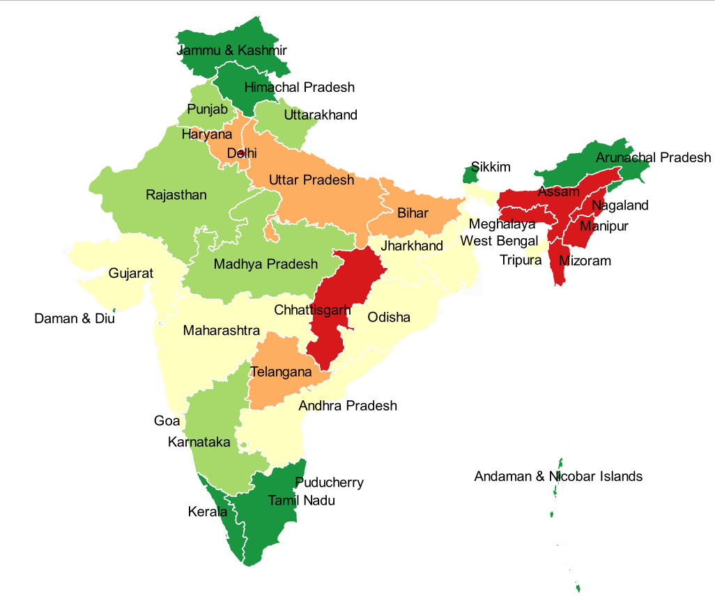
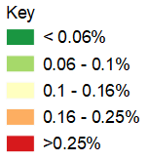
HIV seropositivity at NACO’s supported Blood Centres, by state, 2019-2020
Source: Prepared by www.aidsdatahub.org based on National AIDS Control Organization (2020). Sankalak: Status of National AIDS Response (Second edition, 2020). New Delhi: NACO, Ministry of Health and Family Welfare, Government of India.

Slide 13
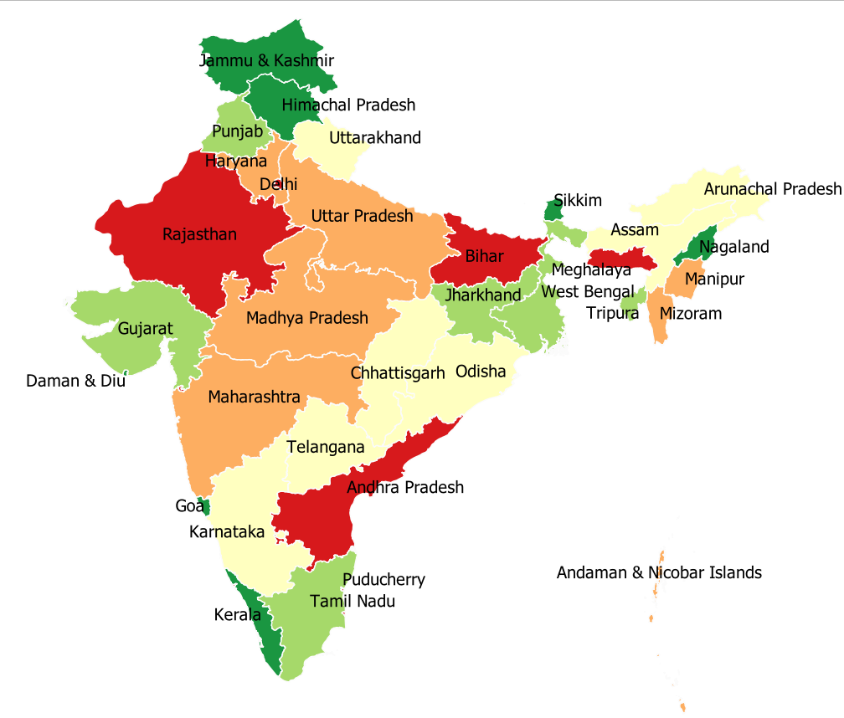
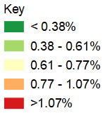
Hepatitis B seropositivity at NACO’s supported Blood Centres, by state, 2019-2020
Source: Prepared by www.aidsdatahub.org based on National AIDS Control Organization (2020). Sankalak: Status of National AIDS Response (Second edition, 2020). New Delhi: NACO, Ministry of Health and Family Welfare, Government of India.

Slide 14
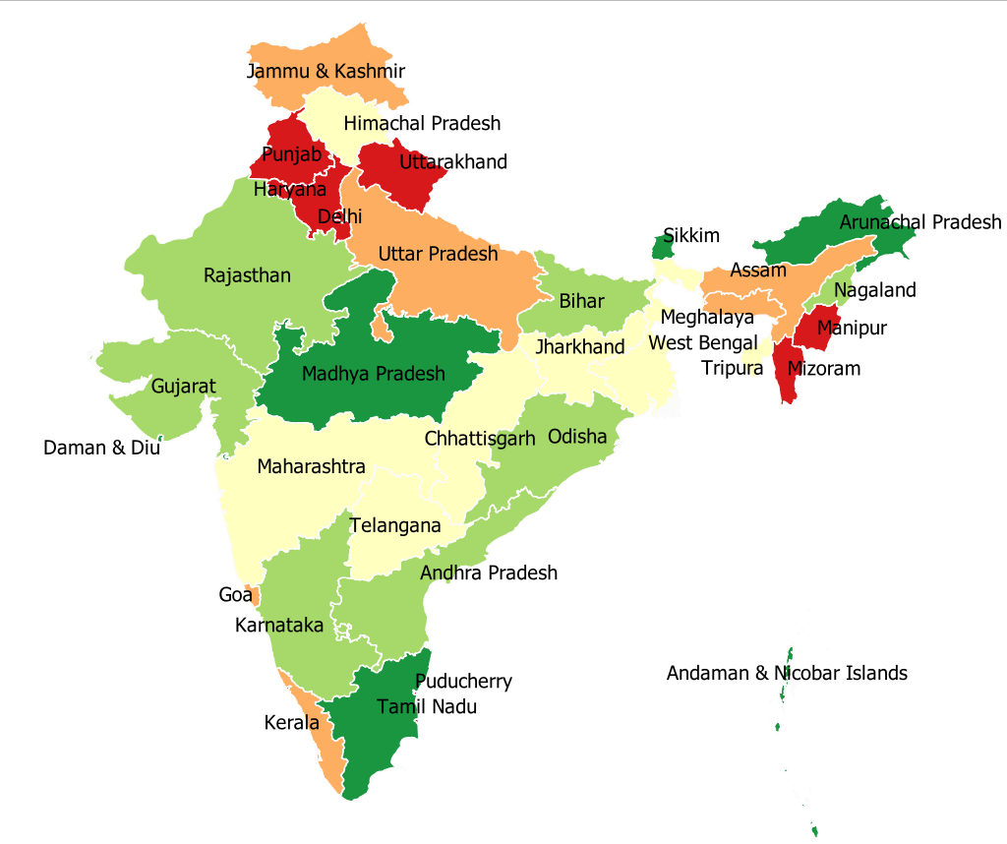
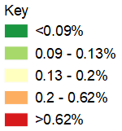
Hepatitis C seropositivity at NACO’s supported Blood Centres, by state, 2019-2020
Source: Prepared by www.aidsdatahub.org based on National AIDS Control Organization (2020). Sankalak: Status of National AIDS Response (Second edition, 2020). New Delhi: NACO, Ministry of Health and Family Welfare, Government of India.

Slide 15
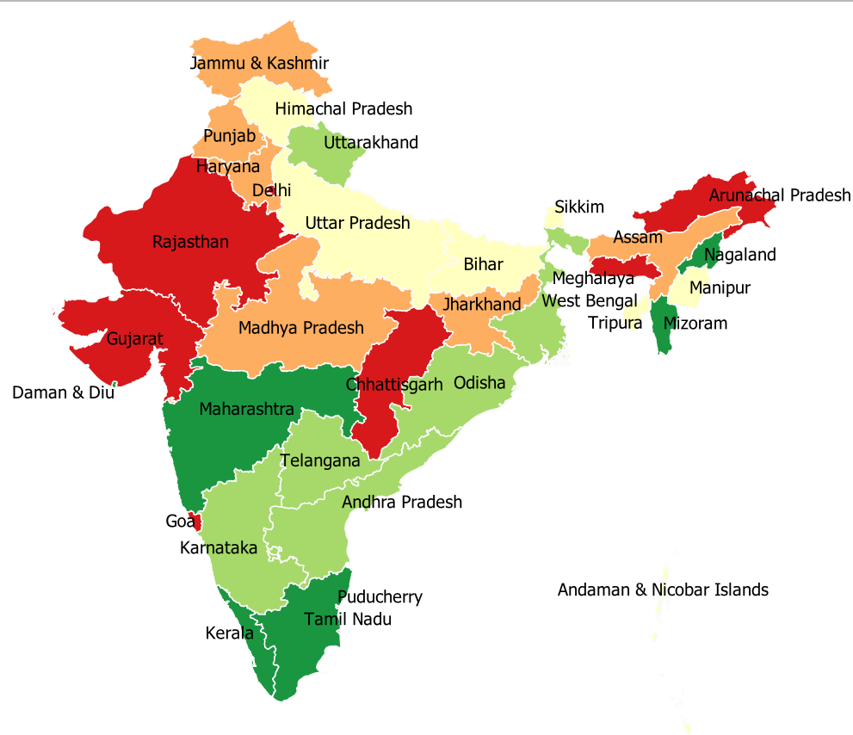
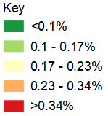
Syphilis seropositivity at NACO’s supported Blood Centres, by state, 2019-2020
Source: Prepared by www.aidsdatahub.org based on National AIDS Control Organization (2020). Sankalak: Status of National AIDS Response (Second edition, 2020). New Delhi: NACO, Ministry of Health and Family Welfare, Government of India.

Slide 16
Proportional distribution of self-reported HIV cases by route of transmission, 2017-2020
Source: Prepared by www.aidsdatahub.org based on National AIDS Control Organization (2020). Sankalak: Status of National AIDS Response (Second edition, 2020). New Delhi: NACO, Ministry of Health and Family Welfare, Government of India.

Slide 17
Risk behaviors

Slide 18
Proportion of key populations who reported condom use at last sex, 2015 and 2020
* with most recent client
** with commercial male partner
Source: Prepared by www.aidsdatahub.org based on www.unaids.aidsinfo.org/kpatlas citing IBBS 2014-2015; and National AIDS Control Organization. (2020). Behavioral Surveillance Survey-Lite: 2020 Top Line Findings

Slide 19
Proportion of people who inject drugs who report using sterile injecting equipment the last time they injected, 2015-2021
Source: Prepared by www.aidsdatahub.org based on Global AIDS Monitoring Report 2023

Slide 20
Proportion of FSW who reported condom use by partner type, 2015 and 2020
Source: Prepared by www.aidsdatahub.org based on National AIDS Control Organization (2015). National Integrated Biological and Behavioral Surveillance (IBBS), India 2014-15. New Delhi: NACO, Ministry of Health and Family Welfare, Government of India; and National AIDS Control Organization. (2020). Behavioral Surveillance Survey-Lite: 2020 Top Line Findings

Slide 21
Proportion of MSM who reported condom use by partner type, 2015 and 2020
Note: IBBS 2014/15 and BSS 2019/20 is not comparable due to differences in methodology used
Source: Prepared by www.aidsdatahub.org based on National AIDS Control Organization (2015). National Integrated Biological and Behavioral Surveillance (IBBS), India 2014-15. New Delhi: NACO, Ministry of Health and Family Welfare, Government of India; and National AIDS Control Organization. (2020). Behavioral Surveillance Survey-Lite: 2020 Top Line Findings

Slide 22
Proportion of transgender who reported condom use by partner type, 2020
Source: Prepared by www.aidsdatahub.org based on Family Welfare, Government of India; and National AIDS Control Organization. (2020). Behavioral Surveillance Survey-Lite: 2020 Top Line Findings

Slide 23
Prisoners who reported condom use at last sex by partner type, 2021
Source: Prepared by www.aidsdatahub.org based on National AIDS Control Organisation. HSS Plus 2021-Central Prison Sites: Technical Report. New Delhi: NACO, Ministry of Health and Family Welfare, Government of India; 2022

Slide 24
Prisoners who reported condom use at last sex with a female sex worker, 2021
Source: Prepared by www.aidsdatahub.org based on National AIDS Control Organisation. HSS Plus 2021-Central Prison Sites: Technical Report. New Delhi: NACO, Ministry of Health and Family Welfare, Government of India; 2022

Slide 25
Vulnerability and HIV knowledge

Slide 26
Proportion of surveyed key populations with comprehensive HIV knowledge, 2020-2021
Source: Prepared by www.aidsdatahub.org based on National AIDS Control Organization. (2020). Behavioral Surveillance Survey-Lite: 2020 Top Line Findings; and National AIDS Control Organisation. HSS Plus 2021-Central Prison Sites: Technical Report. New Delhi: NACO, Ministry of Health and Family Welfare, Government of India; 2022

Slide 27
Proportion of surveyed people who are in prisons with comprehensive HIV knowledge, 2021
Source: Prepared by www.aidsdatahub.org based on National AIDS Control Organisation. HSS Plus 2021-Central Prison Sites: Technical Report. New Delhi: NACO, Ministry of Health and Family Welfare, Government of India; 2022

Slide 28
Proportion of adult men and women with knowledge of HIV by age group and residence, 2015-2016
Source: Prepared by www.aidsdatahub.org based on International Institute for Population Sciences (IIPS) and ICF. 2017. National Family Health Survey (NFHS-4), 2015-16: India. Mumbai: IIPS.

Slide 29
HIV expenditure

Slide 30
AIDS financing, 2022
AIDS spending by financing source*
AIDS spending by service category**
Domestic funding
Other AIDS expenditures
20%
Prevention ***
23%
258
Million US$
International funding*
Care and treatment
57%
* Funding of the AIDS response in India is nearly fully resourced via domestic funding, Data on AIDS spending from international resources are not available; **Distribution of AIDS spending by service category is based on domestic funding only; *** Prevention spending breakdown on key populations is not available.
Source: Prepared by www.aidsdatahub.org based on UNAIDS HIV Financial Dashboard and Global AIDS Monitoring Reporting

Slide 31
National response

Slide 32
Proportion of key populations who received different HIV prevention services in the last 3 months, 2020
Source: Prepared by www.aidsdatahub.org based on National AIDS Control Organization. (2020). Behavioral Surveillance Survey-Lite: 2020 Top Line Findings

Slide 33
Proportion of key populations who received an HIV test in the last 3 months, 2020
* Including HIV testing
Source: Prepared by www.aidsdatahub.org based on National AIDS Control Organization. (2020). Behavioral Surveillance Survey-Lite: 2020 Top Line Findings

Slide 34
Proportion of key populations who received an HIV test in the last 3 months, 2020
Source: Prepared by www.aidsdatahub.org based on National AIDS Control Organization. (2020). Behavioral Surveillance Survey-Lite: 2020 Top Line Findings

Slide 35
Proportion of surveyed people who are in prisons who received an HIV test in the last 12 months, 2021
Source: Prepared by www.aidsdatahub.org based on National AIDS Control Organisation. HSS Plus 2021-Central Prison Sites: Technical Report. New Delhi: NACO, Ministry of Health and Family Welfare, Government of India; 2022

Slide 36
Number of needle/syringes distributed per person who inject drugs per year, 2008-2022
High coverage: >200 syringes per PWID per year
Medium coverage: >100–<200 syringes per PWID per year
Low coverage: <100 syringes per PWID per year
Source: Prepared by www.aidsdatahub.org based on 1) WHO, UNAIDS, & UNICEF. (2009). Towards Universal Access: Scaling up Priority HIV/AIDS Interventions in the Health Sector- Progress Report 2009; 2) WHO, UNAIDS, & UNICEF. (2010). Towards Universal Access: Scaling up Priority HIV/AIDS Interventions in the Health Sector - Progress Report 2010; 3) WHO, UNAIDS, & UNICEF. (2011). Global HIV/AIDS Response Epidemic Update and Health Sector Progress towards Universal Access Progress Report 2011; 4) National AIDS Control Organization India. (2012). Global AIDS Response Progress Report: India; and 5) Global AIDS Monitoring Reporting

Slide 37
Number of Needle and Syringe Programme (NSP) and Opioid Agonist Maintenance Therapy (OAMT), 2011–2020
Source: Prepared by www.aidsdatahub.org based on Global AIDS Response Progress Reporting; and National AIDS Control Organization (2020). Sankalak: Status of National AIDS Response (Second edition, 2020). New Delhi: NACO, Ministry of Health and Family Welfare, Government of India.

Slide 38
Treatment cascade, 2022
* Number of people on ART who received a viral load test in the past year and have viral load of <1000 copies/ml
Source: Prepared by www.aidsdatahub.org based on Global AIDS Monitoring 2023 and UNAIDS 2023 HIV Estimates

Slide 39
HIV testing and treatment cascade, 2022
Source: Prepared by www.aidsdatahub.org based on Global AIDS Monitoring 2023 and UNAIDS 2023 HIV Estimates

Slide 40
ART scale up, 2004-2022
Source: Prepared by www.aidsdatahub.org based on UNAIDS HIV Estimates and Global AIDS Monitoring 2023

Slide 41
Distribution of centers providing ART by state, 2019-2020
India
553 ART centers
1,270 Link ART centers 1,823 Total centers
Source: Prepared by www.aidsdatahub.org based on National AIDS Control Organization (2020). Sankalak: Status of National AIDS Response (Second edition, 2020). New Delhi: NACO, Ministry of Health and Family Welfare, Government of India.

Slide 42
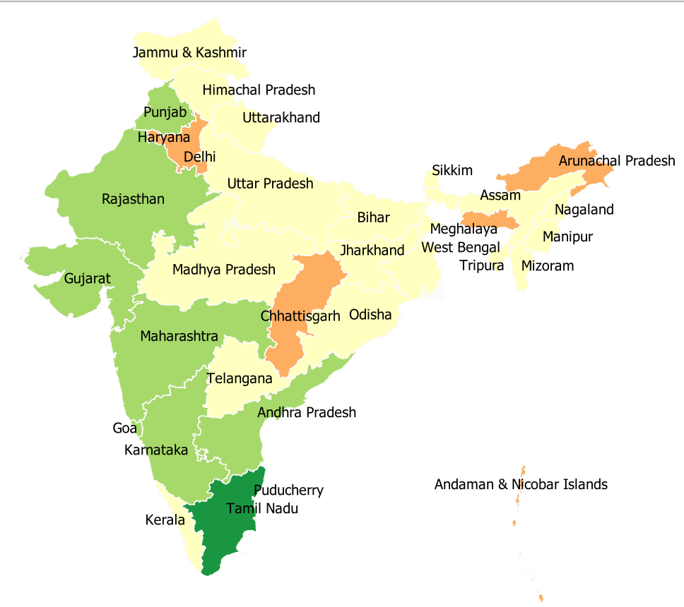
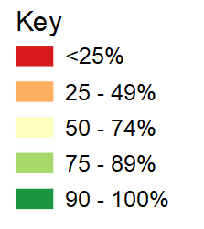
First 90: Proportion of PLHIV who know their HIV status, 2019-2020
Source: Prepared by www.aidsdatahub.org based on National AIDS Control Organization (2020). Sankalak: Status of National AIDS Response (Second edition, 2020). New Delhi: NACO, Ministry of Health and Family Welfare, Government of India.

Slide 43
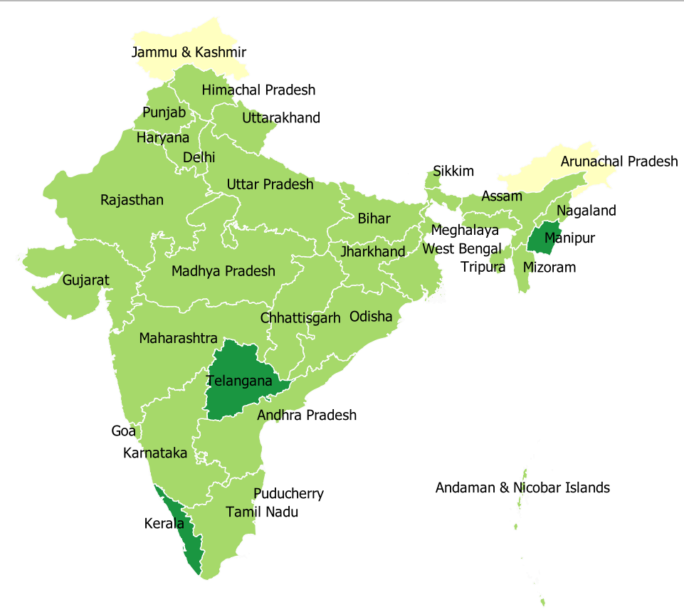
Second 90: Proportion of PLHIV who know their HIV status who are on ART, 2019-2020
Source: Prepared by www.aidsdatahub.org based on National AIDS Control Organization (2020). Sankalak: Status of National AIDS Response (Second edition, 2020). New Delhi: NACO, Ministry of Health and Family Welfare, Government of India.

Slide 44
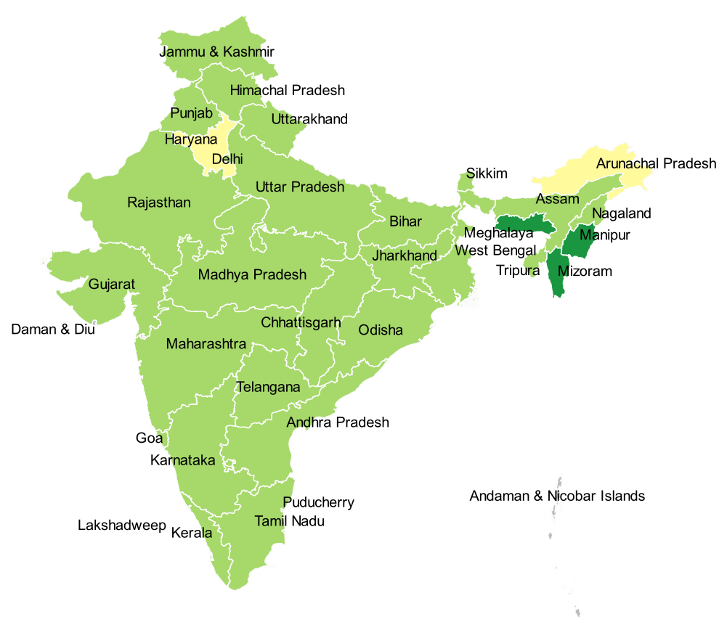
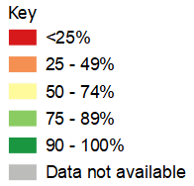
Third 90: Proportion of people on ART who have achieved viral suppression,
2019-2020
Source: Prepared by www.aidsdatahub.org based on National AIDS Control Organization (2020). Sankalak: Status of National AIDS Response (Second edition, 2020). New Delhi: NACO, Ministry of Health and Family Welfare, Government of India.

Slide 45
PMTCT cascade, 2022
Source: Prepared by www.aidsdatahub.org based on Global AIDS Monitoring 2023 and UNAIDS 2023 HIV Estimates

Slide 46
Punitive and discriminatory laws, 2022
Criminalization of TG people | Criminalization of sex work | Criminalization of same-sex sexual acts | Law allows for possession of a certain limited amount of drugs for personal use | Parental consent for adolescents to access HIV testing | Laws or policies restricting the entry, stay and residence of people living with HIV
NO
YES
NO
NO
YES *
NO
* For adolescents <18 yr
Sources: Prepared by www.aidsdatahub.org based on UNAIDS. (2023). The path that ends AIDS: UNAIDS Global AIDS Update 2023. Geneva: Joint United Nations Programme on HIV/AIDS; 2023.

Slide 47
THANK YOU
slides compiled by www.aidsdatahub.org
Data shown in this slide set are comprehensive to the extent they are available from country reports. Please inform us if you know of sources where more recent data can be used.
Please acknowledge www.aidsdatahub.org if slides are lifted directly from this site

