Slide 1
Malaysia
Last updated: Sept 2023

Slide 2
CONTENT
Basic socio-demographic indicators
HIV prevalence and epidemiological status
Risk behaviors
Vulnerability and HIV knowledge
HIV expenditure
National response

Slide 3
BASIC SOCIO-DEMOGRAPHIC INDICATORS
Total population (in thousands) | 30,331 (2015) ¹
Population aged 15-49 (thousands) | 17,209 (2015) ¹
Maternal mortality ratio (per 100 000 live births) | 40 (2015) ⁵
Percentage of population in urban areas | 75 (2015) ²
Antenatal care coverage - At least one visit (%) | 97.15 (2014) ⁷
Crude birth rate (births per 1,000 population) | 16.8 (2014) ²
Under-5 mortality rate (per 1,000 live births) | 7 (2015) ²
Human development index (HDI) - Rank/Value | 62/0.779 (2014) ⁴
Life expectancy at birth (years) - Male/Female | 73/77 (2015) ⁵
Adult literacy rate (%) | 93 (2010) ²
Ratio of girls to boys enrolled at primary level in public and private school (%) | N/A
GDP per capita (PPP, current international $) | 26,891 (2015) ²
Per capita total expenditure on health (PPP int. $) | 1,040 (2014) ³
Sources: Prepared by www.aidsdatahub.org based on 1. UN Population Division. (2015). World Population Prospects: The 2015 Revision - Extended Dataset; 2. World Bank. World Data Bank: World Development Indicators & Global Development Finance. Retrieved July 2016, from http://data.worldbank.org/; 3. WHO. Global Health Observatory Indicator Views: Per Capita Total Expenditure on Health (PPP int. $) (Health Systems), Retrieved July 2016, from http://apps.who.int/gho/data/node.imr.WHS7_105?lang=en; 4. Palanivel, T., Mirza, T., Tiwari, B. N., Standley, S., & Nigam, A. (2016). Asia-Pacific Human Development Report - Shaping the Future: How Changing Demographics Can Power Human Development; 5. WHO. (2016). World Health Statistics 2016: Monitoring health for the SDGs; 6. World Bank Group. (2016). World Development Indicators 2016 and 7 . Ministry of Health Malaysia. (2016). Health Indicators 2015: Indicators for Monitoring and Evaluation of Strategy Health for All.

Slide 4
HIV prevalence and epidemiology

Slide 5
Estimated people living with HIV, new HIV infections and AIDS-related deaths, 1990-2022
Source: Prepared by www.aidsdatahub.org based on UNAIDS HIV estimates 2023

Slide 6
Estimated number of adults (15+) living with HIV and women (15+) living with HIV, 1990-2022
Source: Prepared by www.aidsdatahub.org based on UNAIDS HIV estimates 2023

Slide 7
Key population size estimates, 2018 and 2022
Key population size estimates
Populations | Estimate | Year of estimate
People who inject drugs (PWID) | 60 000 | 2022
Female sex workers (FSW) | 22 000 | 2018
Men who have sex with men (MSM) | 220 000 | 2018
Transgender | 15 000 | 2018
Source: Prepared by www.aidsdatahub.org based on Global AIDS Monitoring and Ministry of Health, Malaysia (2018). Size estimation of key populations in Malaysia – 2018 estimates

Slide 8
HIV prevalence among key populations, 2022
TRANSGENDER PEOPLE
(2022)
MEN WHO HAVE SEX
WITH MEN (2022)
PEOPLE WHO
INJECT DRUGS (2022)
FEMALE
SEX WORKERS (2022)
Source: Prepared by www.aidsdatahub.org based on Integrated Bio-behavioural Survey 2022 and Global AIDS Monitoring 2023

Slide 9
HIV prevalence among key populations by age group, 2012-2022
* Sample size ~ 50
Source: Prepared by www.aidsdatahub.org based on Global AIDS Monitoring Reporting

Slide 10
HIV prevalence among key populations by survey site, 2022
Source: Prepared by www.aidsdatahub.org based on Malaysia Integrated Biological and Behavioral Survey (IBBS) 2022 and Global AIDS Monitoring Reporting

Slide 11
Distribution of reported HIV cases by mode of transmission, Malaysia 1986 - 2021
Source: HIV/STI/Hepatitis C Sector, Division of Disease Control, Ministry of Health Malaysia, 2021

Slide 12
Risk behaviours

Slide 13
Proportion of key populations who reported condom use at last sex, 2012-2022
Source: Prepared by www.aidsdatahub.org based on 1. Ministry of Health, Malaysia. (2004). Behavioural Surveillance Survey of the Sex Worker Population; 2. Yap, I. (2009). The Integrated Bio-Behavioural Surveillance (IBBS) Survey 2009 Malaysia; 3. UNAIDS. (2010). Global Report: UNAIDS Report on the Global AIDS Epidemic; 4. Malaysian AIDS Council. (2009). Risk Behavior and HIV Prevalence among MSM: A Venue-Based Study in Kuala Lumpur, Malaysia; 5. UNAIDS. (2013). Global Report: UNAIDS Report on the Global AIDS Epidemic 2013; 6. Malaysia Ministry of Health. (2015). Global AIDS Response Progress Reporting 2015. (Country narrative report); and 7. www.aidsinfoonline.org

Slide 14
Proportion of female sex workers who reported condom use at last sex by age group, 2012-2022
Source: Prepared by www.aidsdatahub.org based on. Global AIDS Monitoring Reporting

Slide 15
Proportion of men who have sex with men who reported condom use at last sex by age group, 2012-2022
Source: Prepared by www.aidsdatahub.org based on. Global AIDS Monitoring Reporting

Slide 16
Proportion of transgender people who reported condom use at last sex by age group, 2017 and 2022
Source: Prepared by www.aidsdatahub.org based on. Global AIDS Monitoring Reporting

Slide 17
Proportion of people who inject drugs who reported condom use at last sex by age group, 2012 - 2022
Source: Prepared by www.aidsdatahub.org based on. Global AIDS Monitoring Reporting

Slide 18
Proportion of people who inject drugs who reported using sterile injecting equipment, 2012 - 2022
Source: Prepared by www.aidsdatahub.org based on Integrated Bio-Behavioural Surveillance (IBBS) Surveys and Global AIDS Monitoring Reporting

Slide 19
Vulnerability and HIV knowledge

Slide 20
Proportion of key populations with comprehensive HIV knowledge, 2012 - 2014
Source: Prepared by www.aidsdatahub.org based on IBBS reports cited in HIV/AIDS Reporting System and HIV/STI Section. Disease Control Division. Ministry of Health Malaysia. (2015). Global AIDS Response Progress Report 2015 (Country narrative report).

Slide 21
Number and percentage of national service trainees (17-19 yr) with comprehensive HIV knowledge, 2008
Sample size = 6000
Source: Prepared by www.aidsdatahub.org based on Malaysia National Service Survey, MOH, 2008 cited in AIDS/STD Section Disease Control Division Malaysia. (2010 ). UNGASS Country Progress Report: Malaysia 2010.

Slide 22
HIV Expenditure

Slide 23
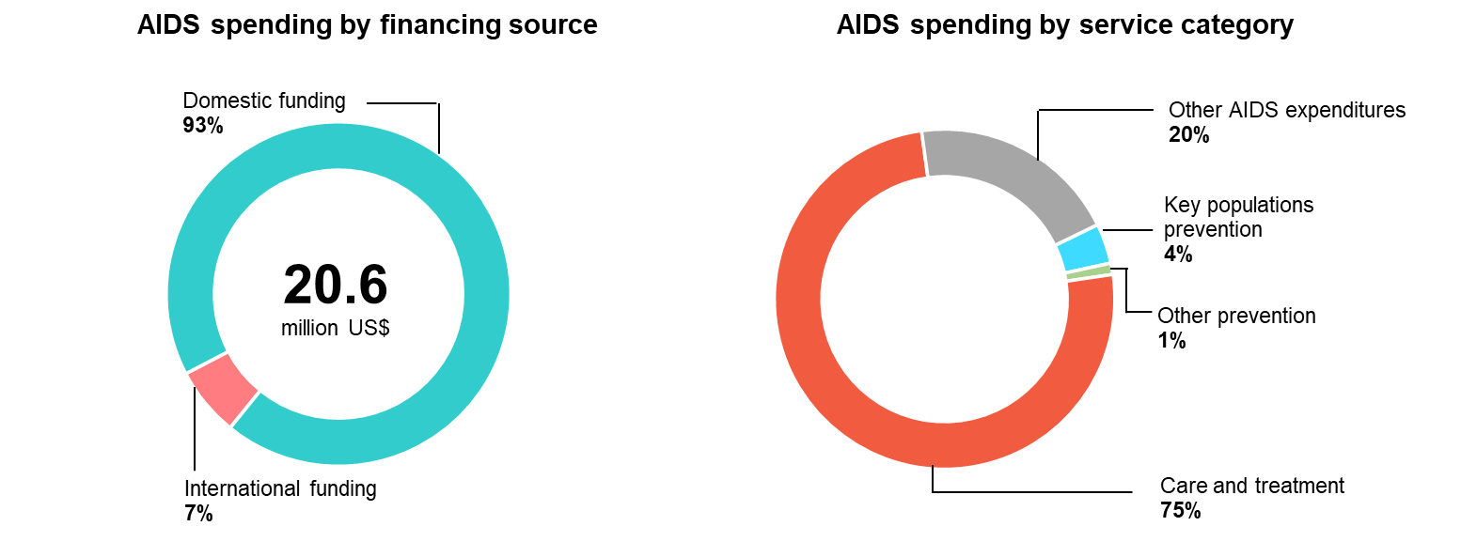
AIDS financing, 2022
Source: Prepared by www.aidsdatahub.org based on Global AIDS Monitoring 2023 and UNAIDS HIV Financial Dashboard

Slide 24
AIDS spending by financing source, 2008 - 2022
Source: Prepared by www.aidsdatahub.org based on UNAIDS Global AIDS Monitoring Reporting and UNAIDS HIV Financial Dashboard

Slide 25
National response

Slide 26
Coverage of opioid agonist maintenance therapy, 2018 - 2022
Source: Prepared by www.aidsdatahub.org based on Global AIDS Monitoring Reporting

Slide 27
Number of needles/syringes distributed per PWID per year, 2009 – 2022
High coverage: >200 syringes per PWID per year
Medium coverage: >100–<200 syringes per PWID per year
Low coverage: <100 syringes per PWID per year
Source: Prepared by www.aidsdatahub.org based on Global AIDS Monitoring Reporting

Slide 28
Number of ART sites and people on ART, 2000-2022
Source: Prepared by www.aidsdatahub.org based on 1. WHO, UNAIDS, & UNICEF. (2010). Towards Universal Access: Scaling up Priority HIV/AIDS Interventions in the Health Sector - Progress Report 2010; 2. Global AIDS Monitoring Reporting ; and 3. UNAIDS HIV Estimates 2023

Slide 29
ART scale-up, 2000 - 2022
Source: Prepared by www.aidsdatahub.org based on UNAIDS HIV estimates 2023

Slide 30
HIV testing and treatment cascade, women (aged 15+ years) compared to men (aged 15+ years), 2022
Source: Prepared by www.aidsdatahub.org based on UNAIDS 2023 HIV Estimates

Slide 31
Estimated adults living with HIV, adults receiving ARVs, and adult ART coverage, 2022
Source: Prepared by www.aidsdatahub.org based on UNAIDS HIV estimates 2023

Slide 32
Treatment cascade, 2022
* Number of people on ART who received a viral load test in the past year and have VL of <1000copies/ml
Source: Prepared by www.aidsdatahub.org based on UNAIDS HIV estimates 2023

Slide 33
HIV testing and treatment cascade, 2022
Source: Prepared by www.aidsdatahub.org based on UNAIDS HIV estimates 2023

Slide 34
Estimated number of pregnant women living with HIV, pregnant women receiving ARVs, and PMTCT coverage, 2022
Source: Prepared by www.aidsdatahub.org based on UNAIDS HIV estimates 2023

Slide 35
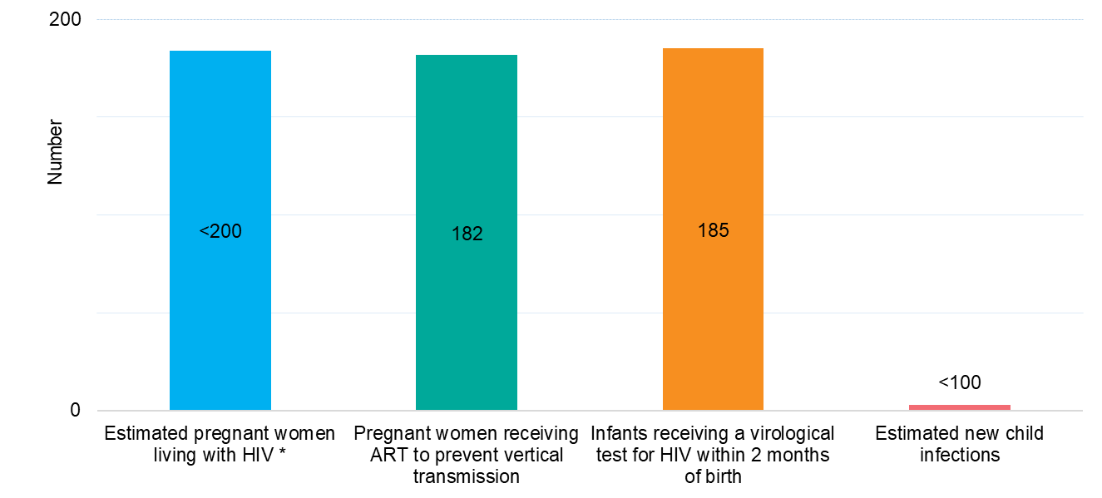
PMTCT cascade, 2022
* Estimated number of women living with HIV who delivered within the past 12 months
Source: Prepared by www.aidsdatahub.org based on UNAIDS HIV estimates 2023

Slide 36
Punitive and discriminatory laws, 2022
Criminalization of TG people | Criminalization of sex work | Criminalization of same-sex sexual acts | Law allows for possession of a certain limited amount of drugs for personal use | Parental consent for adolescents to access HIV testing | Laws or policies restricting the entry, stay and residence of people living with HIV
YES
YES
YES
NO
YES *
YES
* For adolescents <18 yr
Sources: Prepared by www.aidsdatahub.org based on UNAIDS. (2023). The path that ends AIDS: UNAIDS Global AIDS Update 2023. Geneva: Joint United Nations Programme on HIV/AIDS; 2023.

Slide 37
THANK YOU
slides compiled by www.aidsdatahub.org
Data shown in this slide set are comprehensive to the extent they are available from country reports. Please inform us if you know of sources where more recent data can be used.
Please acknowledge www.aidsdatahub.org if slides are lifted directly from this site

