Slide 1
Treatment
Last updated: May 2022

Slide 2
CONTENT
Treatment: Antiretroviral therapy
Treatment: PMTCT
Treatment: TB-HIV Co-treatment

Slide 3
Treatment: Antiretroviral therapy

Slide 4
About half of key populations do not know their HIV status, but assisted testing and self-testing could increase the rates of HIV diagnosis
HIV testing coverage among key populations in Asia and the Pacific, 2016-2020
Female sex workers
Men who have sex with men
Transgender people
People who inject drugs
Regional median*
0%
Note: *Calculated based on 15 reporting countries for female sex workers and men who have sex with men, 9 reporting countries for transgender, and 13 reporting countries for people who inject drugs
Source: Prepared by www.aidsdatahub.org based on Global AIDS Monitoring (GAM) Reporting

Slide 5
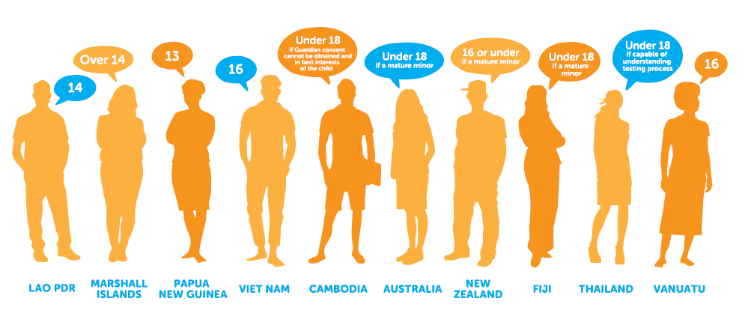
Independent access to HIV testing and related services for young people in Asia and the Pacific
Age of legal capacity to consent independently to an HIV test, Asia and the Pacific
Source: UNICEF, UNESCO, UNFPA, UNODC, Youth LEAD, & Youth Voices Count. (2015). Adolescents Under the Radar in the Asia-Pacific AIDS Response.

Slide 6
Fast-Track Treatment to Reach 90–90–90 by 2020
People receiving ART in Asia and the Pacific
* Fast-Track Target 2020:
4.2 million
people on ART
3.7 million
people were on ART
by 2020
14% and 5% annual increase in 2019 and 2020
Prepared by www.aidsdatahub.org based on UNAIDS 2021 estimates and Global AIDS Monitoring

Slide 7
PROGRESS TOWARDS THE 90–90–90 TARGETS Global versus Asia and the Pacific region, 2020
84%
[67 – >95% ]
87%
[67 – >95%]
90%
[70 – >95%]
Global
76%
[57 – 92%]
84%
[60 – >95%]
>95%
[69 – >95%]
Asia and the
Pacific
Source: Prepared by www.aidsdatahub.org based on UNAIDS. (2021). UNAIDS HIV Estimates 1990-2020
of people living with HIV know their status
of people living with HIV who know their status are on treatment
of people on treatment have achieved viral suppression

Slide 8



Regional overview: Treatment target and gaps
HIV testing and treatment cascade, Asia and the Pacific, 2020
90-81-73 target
78 - 81 - 69
77 - 67 - 64
76 - 62 - 59
ACHIEVED
ACHIEVED
ACHIEVED
Thailand
Australia; Cambodia
Cambodia; Singapore
Thailand
Prepared by www.aidsdatahub.org based on UNAIDS. (2021). UNAIDS HIV Estimates 1990 – 2020

Slide 9
Current treatment scale-up has made significant achievements, but Asia and the Pacific region is lagging behind the global trend
ART coverage and treatment gap, Asia and the Pacific, 2020
*ART coverage for China is calculated based on number of people on ART reported in GAM and country endorsed estimate of PLHIV
Prepared by www.aidsdatahub.org based on UNAIDS. (2021). UNAIDS HIV Estimates 1990 – 2020

Slide 10
In Asia and the Pacific, 4 in 5 children living with HIV are receiving life-saving ART
ART coverage and treatment gap among children, Asia and the Pacific, 2020
2nd 90
target
Prepared by www.aidsdatahub.org based on UNAIDS HIV Estimates 2021

Slide 11
Late diagnosis in Asia and the Pacific: a cause for concern
Prepared by www.aidsdatahub.org based on Global AIDS Monitoring 2021

Slide 12
Generic competition lowers live-saving ART prices
Evolution in price of different first-line regimens
X 10
times lower
Prepared by www.aidsdatahub.org based on Medecins Sans Frontieres (MSF) (2016). Untangling the Web of Antiretroviral Price Reductions -18th Edition

Slide 13
Generic ARVs and impact on government budget: Thailand example
Cost saving comparing with originated product price
Antiretroviral drug (GUL- Government use of license)
Year | Cost saving
 | Mil THB | Mil USD
2010 | 866.3 | 27.3
2011 | 1,732.8 | 56.8
2012 | 2,319.0 | 74.6
2013 | 2,377.1 | 77.3
2014 | 2,870.0 | 88.4
Total saving | 10,165.2 | 338.8
Source: Presentation by Chutima Akaleephan presented at the Regional Experts Consultation on Access to Affordable Medicines, Diagnostics and Vaccines in Bangkok, March 2016 based on NHSO Thailand data

Slide 14
Newer, more effective, less toxic medicines often unaffordable for the poor and developing countries
X17.4
X6.5
US$ per person per year
X2.7
First-line regimen
Second-line regimen
Third-line regimen
Prepared by www.aidsdatahub.org based on Medecins Sans Frontieres (MSF) (2016). Untangling the Web of Antiretroviral Price Reductions -18th Edition

Slide 15
High out of pocket health payment in countries with highest HIV burden
Out-of-pocket payment as % of total health expenditure
Prepared by www.aidsdatahub.org based on http://www.who.int/gho/database/en/

Slide 16
Treatment: PMTCT

Slide 17
Though new HIV infections among children in Asia and the Pacific declined by 32%, the region still missed the 2020 Fast-Track target by 11 000
New HIV infections among children in Asia and the Pacific, 2000-2020
*90% reduction of new HIV infections from 2010 baseline
Source: Prepared by www.aidsdatahub.org based on UNAIDS 2021 HIV Estimates

Slide 18
Efforts are needed to eliminate new HIV infections among children (0-14 years) in Asia and the Pacific
Prevention of mother-to-child transmission (PMTCT) coverage,
Global and Asia and the Pacific, 2010-2020
Source: Prepared by www.aidsdatahub.org based on UNAIDS 2021 HIV Estimates

Slide 19
Towards ending AIDS in children starts with mothers: time to improve linkages and prevent leakages
Service cascade of prevention of mother-to-child transmission of HIV in Asia and the Pacific, 2020
Source: Prepared by www.aidsdatahub.org based on UNAIDS 2021 HIV Estimates

Slide 20
Regional overview: Prevention of mother-to-child transmission
Pregnant women living with HIV who received ARVs to reduce the risk of mother-to-child transmission of HIV, 2020
PMTCT coverage (%)
Source: Prepared by www.aidsdatahub.org based on UNAIDS 2021 HIV Estimates

Slide 21
Regional PMTCT gap, 2020
Regional child new HIV infections gap, 2020
Received PMTCT (2020)
GAP
2020
target
Children new infections (2020)
GAP
2020
target
24,000
8,000
95%
13,000
1,900
0
Prepared by www.aidsdatahub.org based on UNAIDS 2021 estimates and
Global AIDS Monitoring (GAM) reporting

Slide 22
Treatment:
TB-HIV Co-treatment

Slide 23
High TB-HIV burden in Asia and the Pacific, 2020
6.7M
68%
of estimated new TB cases globally
147K
19%
of estimated TB-HIV co-infections globally
847K
57%
of estimated TB mortality globally
Source: Prepared by www.aidsdatahub.org based on WHO. (2021). Global TB Report 2021

Slide 24
Over a third of high TB burden countries are in Asia and the Pacific
30 high-burden countries (Tuberculosis)
Angola | Bangladesh | Brazil | Central African Republic | China
Congo | DPR Korea | DR Congo | Ethiopia | Gabon
India | Indonesia | Kenya | Lesotho | Liberia
Mongolia | Mozambique | Myanmar | Namibia | Nigeria
Pakistan | Papua New Guinea | Philippines | Sierra Leone | South Africa
Thailand | Uganda | UR Tanzania | Viet Nam | Zambia
Source: Prepared by www.aidsdatahub.org based on WHO. (2021). Global TB Report 2021
Asia and the Pacific

Slide 25
Estimated HIV prevalence in incident TB cases, 2020
Source: Prepared by www.aidsdatahub.org based on WHO. (2021). Global TB Report 2021

Slide 26
Need to scale-up HIV testing among TB patients in Asia
Proportion of TB patients with known HIV status, 2020
Source: Prepared by www.aidsdatahub.org based on WHO. (2021). Global TB Report 2021

Slide 27
Need to scale-up HIV testing among TB patients in the Pacific
Proportion of TB patients with known HIV status, 2020
Source: Prepared by www.aidsdatahub.org based on WHO. (2021). Global TB Report 2021

Slide 28
Integrate HIV into systems for health: Integrated efforts are needed to close the health service gaps
Proportion of tuberculosis patients living with HIV who are on antiretroviral therapy
Tuberculosis patients living with HIV on antiretroviral therapy
Tuberculosis patients living with HIV not on antiretroviral therapy
Source: Prepared by www.aidsdatahub.org based on WHO. (2020). Global TB Report 2020

Slide 29
Asia and the Pacific: TB-HIV co-infection
62% of 5.1 M notified TB cases access HIV testing and know their status
TB patients living with HIV know their HIV status and access to antiretroviral therapy
62%
59%
48%
Prepared by www.aidsdatahub.org based on WHO. (2020).Global TB Report and UNAIDS 2020 Estimates

Slide 30
A lot of missed opportunities exist
2 in 3
People co-infected with TB-HIV DO NOT know their HIV status
1 in 3
ART service providers DO NOT provide TB treatment in ART settings
3 in 4
TB service providers DO NOT provide antiretroviral therapy in TB clinics
Source: Prepared by www.aidsdatahub.org based on WHO. (2021). Global TB Report 2021, National Commitments and Policy Instrument (NCPI) and UNAIDS, WHO. Laws and Policies Analytics https://lawsandpolicies.unaids.org/topicresult?i=414&lan=en
Countries in Asia Pacific have TB preventive treatment recommended in national policies and guidelines for people living with HIV
1 in 4
Notes:
The world has the knowledge and the resources to end the interlinked epidemics of tuberculosis and HIV, but political commitment and country action are lacking.
There is need to make integration of services a reality, for the greater benefit of individual and community health while saving resources.

Slide 31
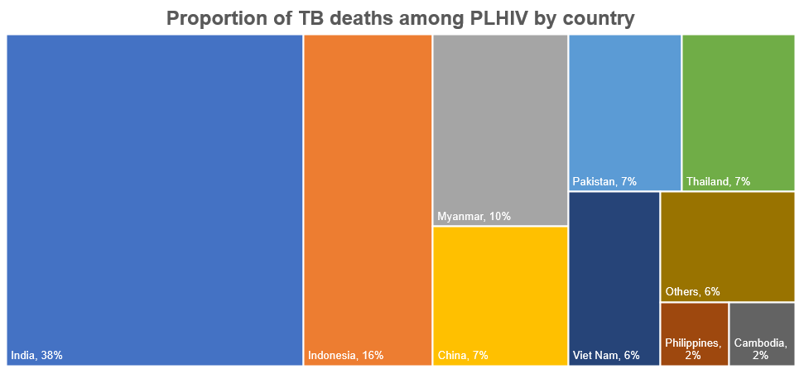
9 countries account for 94% of all TB-related deaths among PLHIV in Asia and the Pacific, 2020
Source: Prepared by www.aidsdatahub.org based on WHO. (2021). Global TB Report 2021

Slide 32
Considerably high proportion of deaths among PLHIV is attributable to TB
TB deaths as proportion of total AIDS-related deaths among PLHIV, 2020
Source: Prepared by www.aidsdatahub.org based on WHO. (2021). Global TB Report 2021 and UNAIDS HIV estimates 2021

Slide 33

All 12 high TB burden countries in Asia and the Pacific have high MDR-TB burden, 2020
 | High TB burden | High MDR-TB burden
Bangladesh
China
DPR Korea
India
Indonesia
Mongolia
Myanmar
Pakistan
Papua New Guinea
Philippines
Thailand
Viet Nam
Source: Prepared by www.aidsdatahub.org based on WHO. (2021). Global TB Report 2021

Slide 34
THANK YOU
slides compiled by www.aidsdatahub.org
Data shown in this slide set are comprehensive to the extent they are available from country reports. Please inform us if you know of sources where more recent data can be used. Please acknowledge www.aidsdatahub.org if slides are lifted directly from this site

