Slide 1
Women and Men
Last updated: May 2022

Slide 2
HIV Prevalence and Epidemiology

Slide 3
Estimated number of adults (15+) living with HIV and women (15+) living with HIV, Asia and the Pacific, 1990-2020
Source: Prepared by www.aidsdatahub.org based on UNAIDS HIV Estimates 2021

Slide 4
Trends in HIV infections and AIDS-related deaths among adult women (15+ yr) in Asia and the Pacific, 1990-2020
Women living with HIV
Women living with HIV
New HIV infections
AIDS-related deaths
New HIV infections among women
AIDS-related deaths among women
Source: Prepared by www.aidsdatahub.org based on UNAIDS HIV Estimates 2021

Slide 5
Estimated HIV prevalence among adults (15-49), 2020
Source: Prepared by www.aidsdatahub.org based on UNAIDS HIV Estimates 2021

Slide 6
HIV prevalence among adults (15-49) and men who have sex with men , 2016-2020
Source: Prepared by www.aidsdatahub.org based on National HIV Sentinel Surveillance Surveys and Integrated Biological and Behavioural Surveys; UNAIDS HIV Estimates 2021; and GAM

Slide 7
Proportion of women and men (15-49) who reported having a genital sore or ulcer in the last 12 months, among those who ever had sex, 2014 – 2018
Source : Prepared by www.aidsdatahub.org based on Demographic and Health Survey (DHS) Reports

Slide 8
Proportion of women and men (15-49) who reported having bad smelling or abnormal genital discharge in the last 12 months, 2014 – 2018
Source : Prepared by www.aidsdatahub.org based on Demographic and Health Survey (DHS) Reports

Slide 9
Vulnerability and HIV Knowledge

Slide 10
Proportion of adults (15-49) with comprehensive knowledge of HIV, 2014 – 2021
* Azad Jammu & Kashmir
** Sindh
*** Khyber Pakhtunkhwa
Source : Prepared by www.aidsdatahub.org based on Demographic and Health Surveys and Multiple Indicator Cluster Surveys

Slide 11
Risk Behaviors

Slide 12
Proportion of adults (15-49 yr) who reported having sex with more than one partner in the last 12 months, 2014 - 2021
Source : Prepared by www.aidsdatahub.org based on Demographic and Health Surveys and Multiple Indicator Cluster Surveys

Slide 13
Proportion of adults (15-49 yr) who reported condom use at last sex among those reporting multiple sex partners in the last 12 months, 2014 - 2021
Source : Prepared by www.aidsdatahub.org based on Demographic and Health Surveys and Multiple Indicator Cluster Surveys

Slide 14
Average number of sexual partners in the lifetime of adults (15-49yr), 2014 - 2018
Source : Prepared by www.aidsdatahub.org based on Demographic and Health Survey (DHS) reports.

Slide 15
Treatment

Slide 16
Treatment coverage among adult men and women living with HIV in Asia and the Pacific, 2020
Source: Prepared by www.aidsdatahub.org based on UNAIDS 2014 HIV estimates and Global AIDS Monitoring (GAM)

Slide 17
Violence

Slide 18
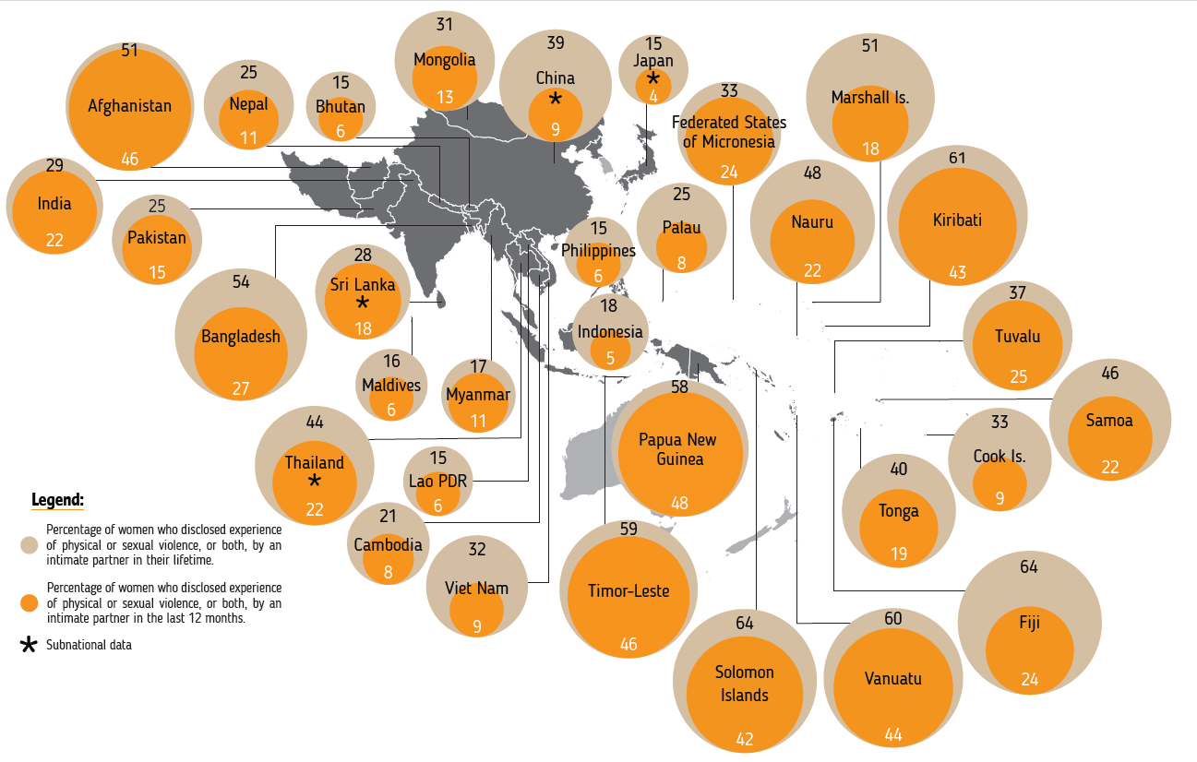

Women who experienced intimate partner violence in Asia and the Pacific, 2000-2019
% of women who reported experience of physical or sexual violence, or both, by an intimate partner in their lifetime
% of women who reported experience of physical or sexual violence, or both, by an intimate partner in the last 12 months.
Source: Violence Against Women - Regional Snapshot. kNOwVAWdata. (July 2020).
Subnational data

Slide 19
Proportion of women (15-49) who experienced violence from intimate partners during pregnancy, 2014-2018
Sources: Prepared by www.aidsdatahub.org based on Demographic and Health Surveys

Slide 20
Proportion of women (15-49) who have ever experienced different forms of violence, 2014 - 2018
%
Source: Prepared by www.aidsdatahub.org based on Demographic and Health Surveys

Slide 21
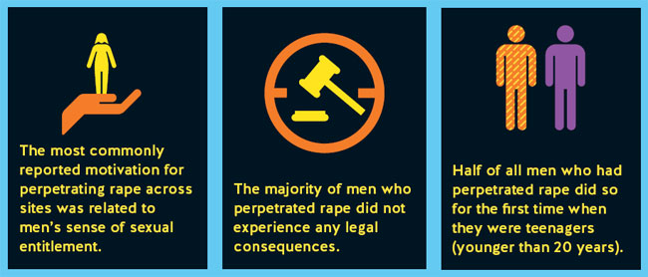
Sexual violence against women
Source: Fulu, E., Warner, X., Miedema, S., Jewkes R., Roselli, T., Lang, J. (2013). Why Do Some Men Use Violence Against Women and How Can We Prevent It? Quantitative Findings from the United Nations Multi-country Study on Men and Violence in Asia and the Pacific. Bangkok: UNDP, UNFPA, UN Women and UNV.

Slide 22
Proportion of women who have experienced sexual violence by spouse or intimate partner, 2015-2020
Source: Prepared by www.aidsdatahub.org based on Demographic and Health Surveys and Multiple Indicator Cluster Surveys

Slide 23
Proportion of adults (15-49 yr) with discriminatory attitudes towards PLHIV, 2014-2021
Note: The proportion of adults 15–49 years old with discriminatory attitudes towards PLHIV is a composite indicator constructed based on respondents indicating ‘No’ to either of the two questions below
Would you buy fresh vegetables from a shopkeeper or vendor if you knew that this person had HIV?
Do you think that children living with HIV should be able to attend school with children who are HIV negative?
*Khyber Pakhtunkhwa
** Sindh
*** Punjab
**** Azad Jammu & Kashmir
%
Source: Prepared by www.aidsdatahub.org based on Demographic and Health Surveys and Multiple Indicator Cluster Surveys

Slide 24
Proportion of adults (15-49) who agree that a husband is justified in beating his wife if she refuses to have sex with him, Asian countries, 2014-2021
* Punjab
** Sindh
*** Azad Jammu & Kashmir
****Khyber Pakhtunkhwa
Source: Prepared by www.aidsdatahub.org based on Demographic and Health Surveys and Multiple Indicator Cluster Surveys

Slide 25
Proportion of adults (15-49) who agree that a husband is justified in beating his wife if she refuses to have sex with him, Pacific Island countries, 2016-2020
Source: Prepared by www.aidsdatahub.org based on Demographic and Health Surveys and Multiple Indicator Cluster Surveys

Slide 26
Proportion of women who believe that a wife is justified in refusing sex with her husband if she knows the husband has sex with other women, 2014 - 2018
Source: Prepared by www.aidsdatahub.org based on Demographic and Health Surveys

Slide 27
National Response

Slide 28
Proportion of adults (15-49) who know a place to get an HIV test, 2014 - 2021
Source : Prepared by www.aidsdatahub.org based on Demographic and Health Surveys and Multiple Indicator Cluster Surveys

Slide 29
Proportion of adults (15-49) who received an HIV test in the last 12 months and knew the results in Asia, 2014 - 2021
Source : Prepared by www.aidsdatahub.org based on Multiple Indicator Cluster Survey (MICS) reports and Demographic and Health Survey (DHS) reports

Slide 30
Proportion of adults (15-49) who received an HIV test in the last 12 months and knew the results, Pacific Island Countries and Territories, 2018 – 2020
Source : Prepared by www.aidsdatahub.org based on Multiple Indicator Cluster Survey (MICS) reports

Slide 31
THANK YOU
slides compiled by www.aidsdatahub.org
Data shown in this slide set are comprehensive to the extent they are available from country reports. Please inform us if you know of sources where more recent data can be used.
Please acknowledge www.aidsdatahub.org if slides are lifted directly from this site

