Slide 1
Young People (15-24 year)
Last updated: March 2022

Slide 2
CONTENT
HIV prevalence and epidemiology
Risk behaviors
Vulnerability and HIV knowledge
National response

Slide 3
HIV Prevalence and Epidemiology

Slide 4
HIV and AIDS among young people (15-24 yr) in Asia and the Pacific 2000-2020
2020 “zoom-in”
63 000
New HIV infections
370 000
Young people living with HIV
3 000
AIDS-related deaths
Source: Prepared by www.aidsdatahub.org based on UNAIDS 2021 HIV Estimates
Young men
Young women

Slide 5
Though new HIV infections among young people in Asia and the Pacific declined by 32%, the region still missed the 2020 Fast-Track target by 40 000
New HIV infections among young people 15-24 yr in Asia and the Pacific, 2000-2020
Source: Prepared by www.aidsdatahub.org based on UNAIDS 2021 HIV Estimates
*75% reduction of new HIV infections from 2010 baseline

Slide 6
Snapshot of young people and HIV infections in Asia and the Pacific, 2020
Young people 15-24 yr
Other populations
5.8 million PLHIV
240 000 new HIV infections
Young women 15-24 yr
Young men 15-24 yr
Source: Prepared by www.aidsdatahub.org based on UNAIDS 2021 HIV Estimates

Slide 7
370,000 young people (15-24) were living with HIV in 2020, 6% of all people living with HIV in Asia and the Pacific
Young people living with HIV, 2000 - 2020
320,000 young female (15-24)
370,000 young male (15-24)
Source: Prepared by www.aidsdatahub.org based on UNAIDS 2021 HIV Estimates

Slide 8
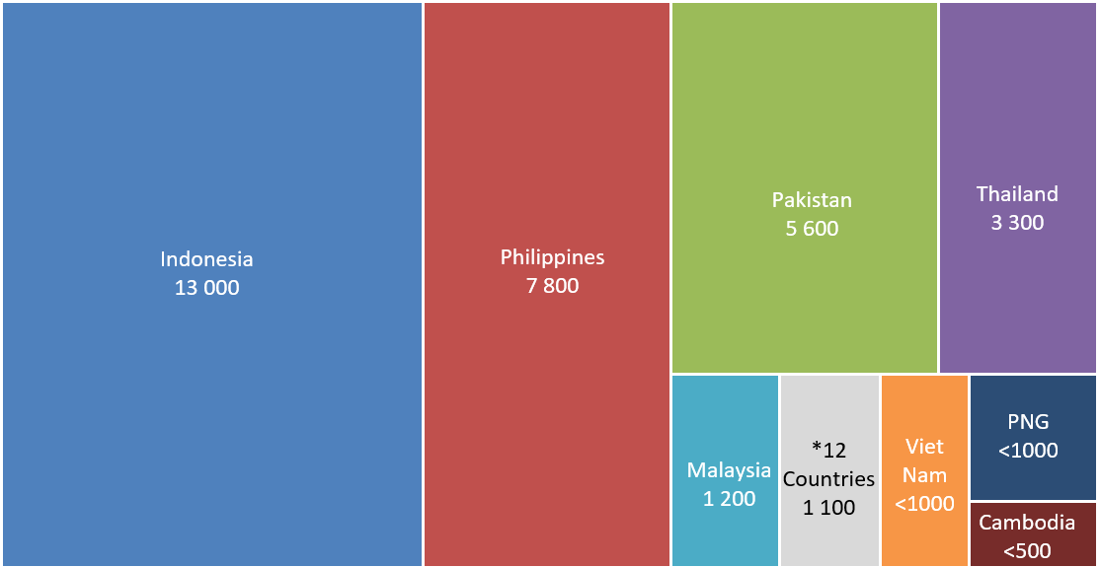
Distribution of new HIV infections among young people (15-24) in Asia and the Pacific, 2020
320,000 young female (15-24)
* The 12 countries include Afghanistan, Australia, Bhutan, Fiji, Japan, Lao PDR, Mongolia, Nepal, New Zealand, Singapore, Sri Lanka and Timor-Leste
Note: Countries including Bangladesh, China, India, Brunei, Maldives, Myanmar, Republic of Korea and Korea DPR did not publish their estimates for new HIV infections among young people
370,000 young male (15-24)
Source: Prepared by www.aidsdatahub.org based on UNAIDS 2021 HIV Estimates

Slide 9
Vulnerability and HIV Knowledge

Slide 10
Proportion of young people (15-24) with comprehensive HIV knowledge, 2013-2021
* Azad Jammu & Kashmir
Source : Prepared by www.aidsdatahub.org based on UNGASS and Global AIDS Response Progress Reporting; 2. Demographic and Health Survey (DHS) Reports; 3. Multiple Indicator Cluster Survey (MICS) Reports; and other population based surveys

Slide 11
Proportion of young people (15-24) who know at least one formal source of condom, 2009 – 2017
Source : Prepared by www.aidsdatahub.org based on Demographic and Health Surveys

Slide 12
Risk Behaviors

Slide 13
Proportion of young people (15-24) who had sex before the age of 15, countries where data is available, 2014-2021
Source: Prepared by www.aidsdatahub.org based on www.aidsinfoonline.org; Demographic and Health Surveys; and Multiple Indicator Cluster Surveys

Slide 14
Proportion of sexually active young people (15-24 yr) who had multiple partners, and who reported condom use at last sex in the last 12 months, 2014-2018
Source : Prepared by www.aidsdatahub.org based on Demographic and Health Surveys

Slide 15
Proportion of never married, young people (15-24 yr) who reported engaging in premarital sex in the last 12 months, 2014-2018
Source : Prepared by www.aidsdatahub.org based on Demographic and Health Survey (DHS) Reports

Slide 16
National Response

Slide 17
Proportion of young people (15-24) who know where to get an HIV test, 2014-2021
Source : Prepared by www.aidsdatahub.org based on Demographic and Health Survey (DHS) Reports and Multiple Indicator Cluster Survey (MICS) Reports

Slide 18
Proportion of young people (15-24) who received an HIV test in the last 12 months and knew the results, 2014-2021
Source : Prepared by www.aidsdatahub.org based on Demographic and Health Survey (DHS) Reports and Multiple Indicator Cluster Survey (MICS) Reports

Slide 19
Knowledge of where to get an HIV test, and HIV testing coverage among young people (15-24) in Pacific Island countries, 2018-2020
Source : Prepared by www.aidsdatahub.org based on Demographic and Health Survey (DHS) Reports and Multiple Indicator Cluster Survey (MICS) Reports

Slide 20
Laws and regulations that allow adolescents (10-19 years) to seek services without parental/spousal consent, countries where data is available, 2013-2019
Country (reporting period) | Contraceptive services except sterilization | Emergency contraception | Harm reduction intervention for injectable drug users | HIV testing and counselling services
Afghanistan (Apr 2016, 2019)
Bangladesh (Feb 2014, 2019)*
Bhutan (Jan 2016)
Brunei Darussalam (Feb 2014, 2019)
Cambodia (Mar 2016, 2019)**
China (2019)
Fiji (2018)
India (Feb 2014, 2019)*
Indonesia (Apr 2016, 2018)***
Kiribati (Jun 2014)
Lao PDR (Mar 2016, 2017)**
Malaysia (Mar 2016, 2019)*
Maldives (Jan 2010)
Marshall Islands (Apr 2016)
Micronesia (Federated States of) (Mar 2016)
Mongolia (Mar 2016, 2019)*
Myanmar (Apr 2016, 2019)
Nepal (Jan 2014, 2019)***
Pakistan (Dec 2016, 2019)*
Palau (Apr 2016)
Papua New Guinea (Jan 2014, 2019)*
Philippines (Mar 2014, 2019)*
Solomon Islands (Mar 2016)
Sri Lanka (Apr 2016)
Timor-Leste (Apr 2016)
Vanuatu (Dec 2013)
Thailand (2018)
Viet Nam (Jan 2014, 2019)***
Yes
No
No information
Note: Asterisks refer to HIV testing and counseling services
*for adolescents younger than 18 years
**for adolescents younger than 14 years
*** for adolescents younger than 16 years
Source: Prepared by www.aidsdatahub.org based on information from countries that responded to the Global Maternal, Newborn, Child and Adolescent Health Policy Indicator Surveys (2009-10, 2011-12, 2013-14, 2016) undertaken by Department of Maternal, Newborn, Child and Adolescent Health; World Health Organization - http://www.who.int/maternal_child_adolescent/epidemiology/policy-indicators/en/ (accessed 04 Sept 2019); and National Commitments and Policies Instrument of Global AIDS Monitoring (GAM) 2017,2018, and 2019

Slide 21
THANK YOU
slides compiled by www.aidsdatahub.org
Data shown in this slide set are comprehensive to the extent they are available from country reports. Please inform us if you know of sources where more recent data can be used.
Please acknowledge www.aidsdatahub.org if slides are lifted directly from this site

