Slide 1
Stigma and discrimination, Gender-based violence and HIV
Last updated: January 2021

Slide 2
Violence, stigma and discrimination against key populations

Slide 3
Proportion of female sex workers who experienced physical violence, 2012-2017
Source: Prepared by www.aidsdatahub.org based on Behavioral Surveys and Integrated Biological and Behavioral Surveys

Slide 4
Proportion of female sex workers who were forced to have sex in the 12 months, 2014-2017
Source: Prepared by www.aidsdatahub.org based on Behavioral Surveys and Integrated Biological and Behavioral Surveys

Slide 5
Proportion of MSM who had been raped/forced to have sex in the last 12 months, 2010-2017
Source: Prepared by www.aidsdatahub.org based on 1) Integrated Biological and Behavioral Surveys ; and 2. Behavioral Surveillance Surveys

Slide 6
Prevailing stigma, discrimination and violence against MSW, countries where data is available, 2015-2017
* Experienced in the last 12 months
** Ever beaten or forced to have sex
Source: Prepared by www.aidsdatahub.org based on Integrated Behavioral and Surveillance Surveys

Slide 7
Prevailing stigma, discrimination and violence against MSM
Physical violence
Sexual violence
Stigma and mental health
* Experienced violence or rape in the last year
Source: Prepared by www.aidsdatahub.org based on Integrated Behavioral and Surveillance Surveys

Slide 8
Prevailing stigma, discrimination and violence against transgender people
* Experienced in the last 12 months; Arrested – ever arrested in Cambodia and last 12 months in Pakistan Data reported for PNG is a mixed survey sample of MSM and TG
Source: Prepared by www.aidsdatahub.org based on Integrated Behavioral and Surveillance Surveys

Slide 9
Social justice and human rights are fundamental to address the public health needs of transgender women
In India…
1 in 5
Transgender women
experienced sexual violence in last 12 months
In Bangladesh…
1 in 4
Transgender women
reported being raped in last 12 months
In Cambodia…
1 in 5
Transgender women
have been denied/thrown out
of a housing in their life time
In Pakistan…
1 in 6
Transgender women
have been denied healthcare
in their life time
Prepared by www.aidsdatahub.org based on Integrated Biological and Behavioral Surveys

Slide 10

Stigma: a major barrier to HIV and health services
63% felt ashamed
21% avoided going to local clinic
14% denied health services
Access to health services
9% denied SRH services
32% late diagnosis*
Multiple layers of stigma also experienced by sex workers, MSM, TG, people who use drugs, migrants.
Averages from PLHIV Stigma Index in 14 countries in the region (2008-2014)
*Late diagnosis- CD4<200 at the time of diagnosis
(based on treatment programme data)

Slide 11
Proportion of key populations who avoided seeking healthcare in the last 12 months due to fear of stigma, countries where data is available, 2017-2019
Source: Prepared by www.aidsdatahub.org based on Integrated Behavioral and Surveillance Surveys and Global AIDS Monitoring (GAM)

Slide 12
Proportion of key population who avoided seeking healthcare in the last 12 months due to fear of stigma, sub-national data in countries where data is available, 2019
Source: Prepared by www.aidsdatahub.org based on Integrated Behavioral and Surveillance Surveys and Global AIDS Monitoring (GAM)

Slide 13
Proportion of key populations who avoided HIV testing in the last 12 months due to fear of stigma, countries where data is available, 2017-2019
Source: Prepared by www.aidsdatahub.org based on Integrated Behavioral and Surveillance Surveys and Global AIDS Monitoring (GAM)

Slide 14
Proportion of key populations who avoided HIV testing in the last 12 months due to fear of stigma, sub-national data in countries where data is available, 2018-2019
Source: Prepared by www.aidsdatahub.org based on Integrated Behavioral and Surveillance Surveys and Global AIDS Monitoring (GAM)

Slide 15
Proportion of MSM and FSW who avoided seeking healthcare/HIV testing services in the last 12 months due to fear of stigma, 2017-2019
Source: Prepared by www.aidsdatahub.org based on Integrated Behavioral and Surveillance Surveys and Global AIDS Monitoring (GAM)

Slide 16
Proportion of key populations who avoided HIV testing services for fear of stigma Versus HIV testing coverage, countries where data is available, 2017-2018
Source: Prepared by www.aidsdatahub.org based on Integrated Behavioral and Surveillance Surveys and Global AIDS Monitoring (GAM)

Slide 17
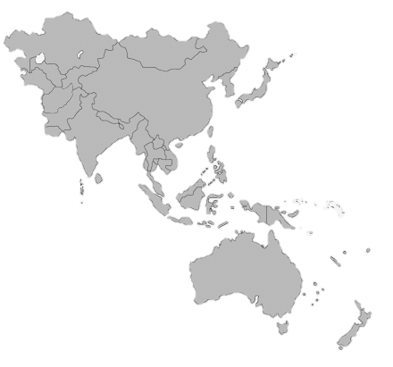
Support countries to put in place guarantees against discrimination in law, policies, and regulations
Legal barriers to the HIV response remain in 38 UN Member States in
Asia and the Pacific
criminalize some aspect of sex work
37
16
criminalize same-sex relations
confine people who use drugs in compulsory detention centres
11
38 countries in Asia and the Pacific region
Countries with punitive laws
impose death penalty for drug-related offences
15
impose some form of HIV-related restriction on entry, stay or residence
10
Asia and the Pacific
Source: Prepared by www.aidsdatahub.org based on UNAIDS, Punitive Laws Hindering the HIV Response in Asia and the Pacific (as of June 2016); and https://timesofindia.indiatimes.com/realtime/sc_decriminalises_section_377_read_full_judgement.pdf

Slide 18
Violence, stigma and discrimination against people living with HIV

Slide 19
Proportion of adults (15-49 yr) with discriminatory attitudes towards PLHIV, 2015-2019
Note: The proportion of adults 15–49 years old with discriminatory attitudes towards PLHIV is a composite indicator constructed based on respondents indicating ‘No’ to either of the two questions below
Would you buy fresh vegetables from a shopkeeper or vendor if you knew that this person had HIV?
Do you think that children living with HIV should be able to attend school with children who are HIV negative?
%
Source: Prepared by www.aidsdatahub.org based on Demographic and Health Surveys, Multiple Indicator Cluster Surveys and Global AIDS Monitoring (GAM)

Slide 20
Proportion of adults (15-49 yr) who would NOT buy fresh vegetables from a shopkeeper or vendor who is HIV positive, 2012-2018
Source: Prepared by www.aidsdatahub.org based on Demographic and Health Surveys, Multiple Indicator Cluster Surveys and Global AIDS Monitoring (GAM)

Slide 21
Proportion of adults (15-49 yr) who believe that children living with HIV should NOT be allowed to attend school with children who are HIV negative, 2015-2019
Source: Prepared by www.aidsdatahub.org based on Demographic and Health Surveys, Multiple Indicator Cluster Surveys and Global AIDS Monitoring (GAM)

Slide 22
Proportion of PLHIV who experienced HIV-related stigma and discrimination in health-care settings during the past 12 months
* Respondent identifies with at least one key population
Source: Prepared by www.aidsdatahub.org based on Integrated Behavioral and Surveillance Surveys and Global AIDS Monitoring (GAM)

Slide 23
Proportion of PLHIV who reported that they were denied health services and employment opportunities because of their HIV status, 2014-2018
Source: Prepared by www.aidsdatahub.org based on People Living With HIV Stigma Index Reports

Slide 24
Proportion of PLHIV who reported that they avoided seeking health services for fear of stigma due of their HIV status, 2014-2018
* Western Highlands
Source: Prepared by www.aidsdatahub.org based on People Living With HIV Stigma Index Reports

Slide 25
Proportion of PLHIV reporting different forms of internalized stigma, 2014-2019
*7 Pacific Islands including Marshall Islands, Federated States of Micronesia, Kiribati, Vanuatu, Tonga, Samoa, Palau ** Western Highlands
Source: Prepared by www.aidsdatahub.org based on People Living With HIV Stigma Index Reports

Slide 26
Proportion of women living with HIV who had a desire to have children reported being coerced to undergo sterilization, 2012-2013
Source: Prepared by www.aidsdatahub.org based on http://apnmata.org/country-profiles/

Slide 27
Proportion of surveyed HIV-positive pregnant women who were asked to undergo sterilization, 2011
Source: Prepared by www.aidsdatahub.org based on Women of the Asia Pacific Network of People Living with HIV (APN+). (2012). Positive and Pregnant. How Dare You. A study on access to reproductive and maternal health care for women living with HIV in Asia. Bangkok.

Slide 28
Number of HIV-positive pregnant women who were asked to undergo sterilization and had the option to decline, 2011
Source: Prepared by www.aidsdatahub.org based on Women of the Asia Pacific Network of People Living with HIV. (2012). ‘Positive and Pregnant. How Dare You. A study on access to reproductive and maternal health care for women living with HIV in Asia. Bangkok.

Slide 29
Violence against women in the general population

Slide 30
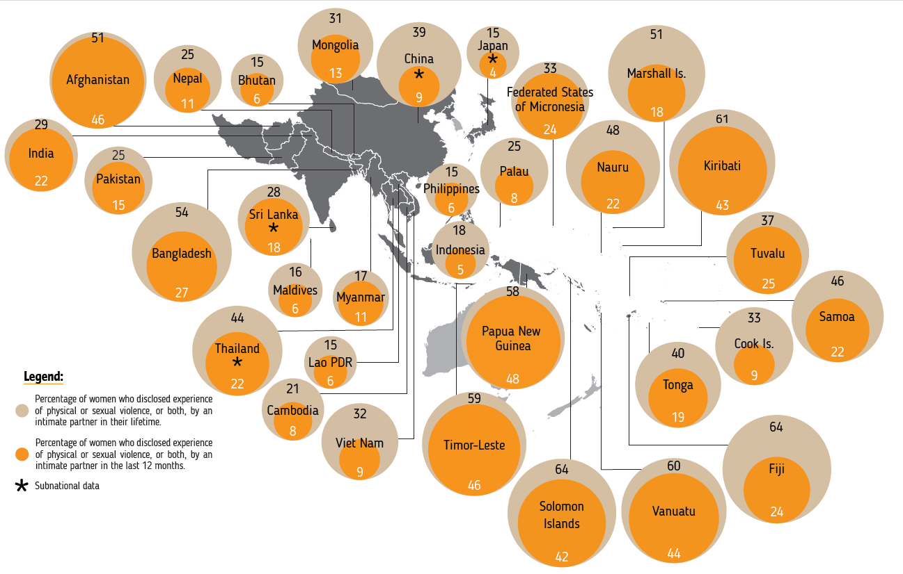

Women who experienced intimate partner violence in Asia and the Pacific, 2000-2019
% of women who reported experience of physical or sexual violence, or both, by an intimate partner in their lifetime
% of women who reported experience of physical or sexual violence, or both, by an intimate partner in the last 12 months.
Source: Violence Against Women - Regional Snapshot. kNOwVAWdata. (July 2020).
Subnational data

Slide 31
Proportion of women (15-49) who experienced violence from intimate partners during pregnancy, 2014-2018
Sources: Prepared by www.aidsdatahub.org based on Demographic and Health Surveys

Slide 32
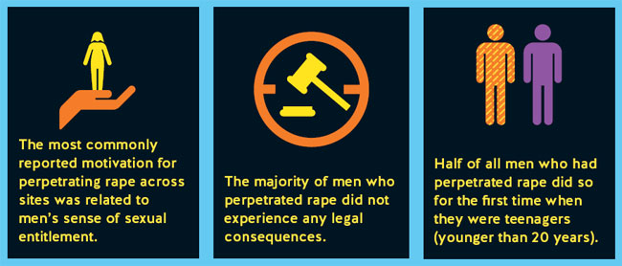
Sexual violence against women
Source: Fulu, E., Warner, X., Miedema, S., Jewkes R., Roselli, T., Lang, J. (2013). Why Do Some Men Use Violence Against Women and How Can We Prevent It? Quantitative Findings from the United Nations Multi-country Study on Men and Violence in Asia and the Pacific. Bangkok: UNDP, UNFPA, UN Women and UNV.

Slide 33
Proportion of women (15-49) who have ever experienced different forms of violence, 2015-2018
%
Source: Prepared by www.aidsdatahub.org based on Demographic and Health Surveys

Slide 34
Proportion of women (15-49) who experienced physical violence from an intimate partner in the last 12 months, 2007-2018
Source: Prepared by www.aidsdatahub.org based on Demographic and Health Surveys

Slide 35
Proportion of women who have experienced sexual violence by spouse or intimate partner, 2015-2018
Source: Prepared by www.aidsdatahub.org based on Demographic and Health Surveys

Slide 36
Proportion of women who believe that a wife is justified in refusing sex with her husband if she knows the husband has sex with other women, 2015-2018
Source: Prepared by www.aidsdatahub.org based on Demographic and Health Surveys

Slide 37
Proportion of men (15-49) who agree that a husband is justified in hitting or beating his wife if she refuses to have sexual intercourse with him, 2012-2018
Source: Prepared by www.aidsdatahub.org based on Demographic and Health Surveys

Slide 38
Proportion of adults (15-49) who agree that a husband is justified in hitting or beating his wife if she refuses to have sexual intercourse with him, 2015-2018
Source: Prepared by www.aidsdatahub.org based on Demographic and Health Surveys

Slide 39
Acceptance of violence prevents women from reporting violence
Reported prevalence of physical and/or sexual intimate partner violence
by site, comparison of men (perpetrated) and women (experienced) reports
Source: Fulu, E., Warner, X., Miedema, S., Jewkes R., Roselli, T., Lang, J. (2013). Why Do Some Men Use Violence Against Women and How Can We Prevent It? Quantitative Findings from the United Nations Multi-country Study on Men and Violence in Asia and the Pacific. Bangkok: UNDP, UNFPA, UN Women and UNV.

Slide 40
THANK YOU
slides compiled by www.aidsdatahub.org and UNAIDS Regional Support Team for Asia and the Pacific
Data shown in this slide set are comprehensive to the extent they are available from country reports. Please inform us if you know of sources where more recent data can be used.
Please acknowledge www.aidsdatahub.org if slides are lifted directly from this site.

