Slide 1
DPR Korea

Slide 2
CONTENT
Basic socio-demographic indicators
HIV prevalence and epidemiological status
Risk behaviors
Vulnerability and HIV knowledge
HIV expenditure
National response

Slide 3
BASIC SOCIO-DEMOGRAPHIC INDICATORS
Total population (in thousands) | 25,027 (2014)¹
Annual population growth rate | 0.5 (2014)¹
Population aged 15-49 (thousands) | 13,554 (2014)¹
Percentage of population in urban areas | 61 (2013)²
Crude birth rate (births per 1,000 population) | 14.4 (2012)²
Under-5 mortality rate (per 1,000 live births) | 29 (2012)³
Human development index (HDI) - Rank/Value | N/A
Life expectancy at birth (years) | 70.0 (2013)⁴
Adult literacy rate (%) | 100.0 (2005-2012)⁴
Ratio of girls to boys in primary and secondary education (%) | N/A
GDP per capita (PPP, $US) | N/A
Per capita total health expenditure (Int.$) | N/A
Sources: Prepared by www.aidsdatahub.org based on 1. UN Population Division. (2013). World Population Prospects: The 2012 Revision - Extended Dataset; 2.World Bank. World Data Bank: World Development Indicators & Global Development Finance. Retrieved October, 2014, from h​t​t​p​:​/​/​d​a​t​a​b​a​n​k​.​w​o​r​l​d​b​a​n​k​.​o​r​g​; 3. WHO. (2014). World Health Statistics 2014; and 4. UNDP. (2014). Human Development Report 2014 Sustaining Human Progress: Reducing Vulnerabilities and Building Resilience.

Slide 4
HIV prevalence and epidemiological status

Slide 5
Risk behaviours

Slide 6
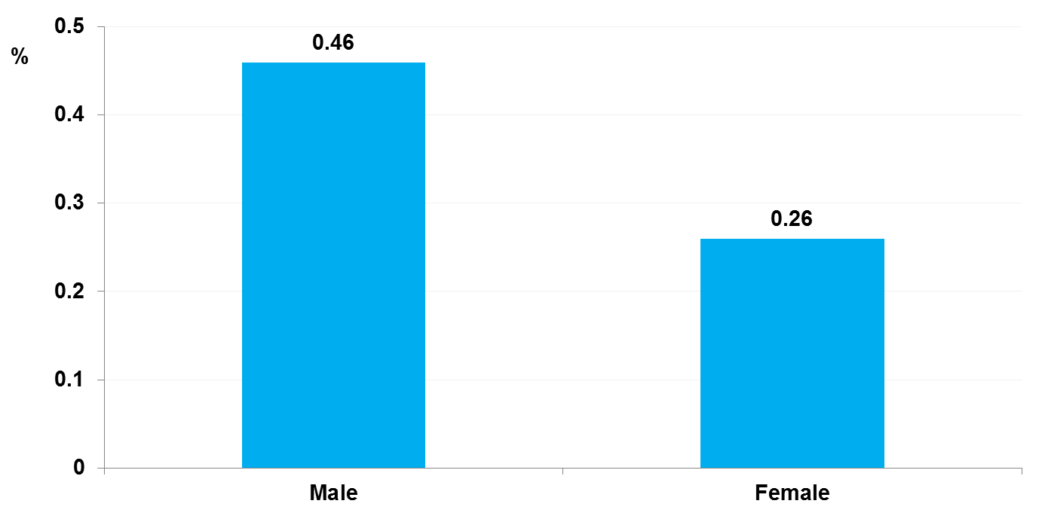
Proportion of young people (15-19) who ever used a condom, 2004
Source: Prepared by www.aidsdatahub.org based on European Union, WHO, UNICEF, et al. (2006). DPR Korea: Epidemiological Fact Sheet on HIV/AIDS and Sexually Transmitted Infections- 2006 Update

Slide 7
Vulnerability and HIV knowledge

Slide 8
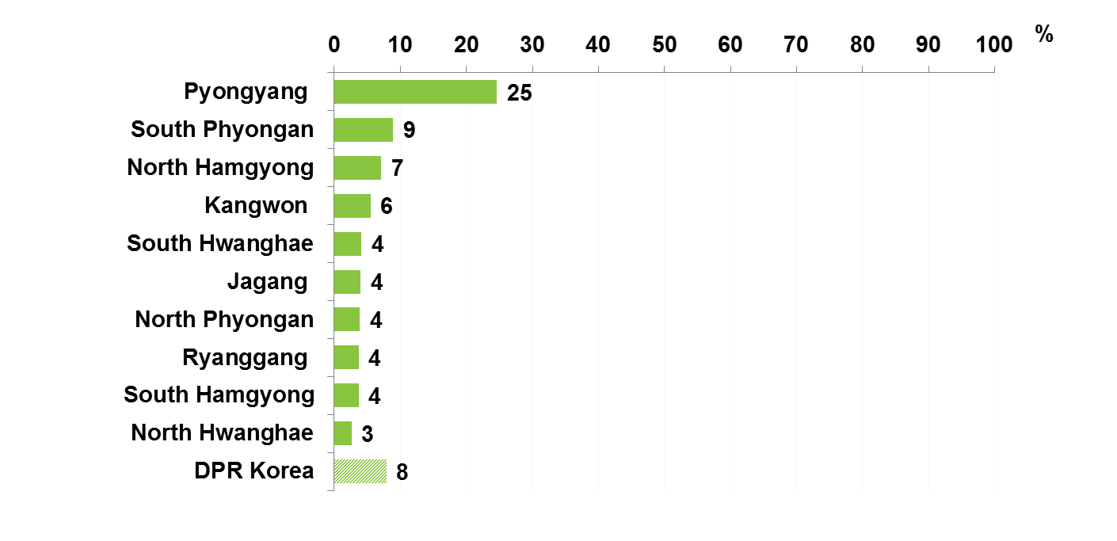
Proportion of young women with comprehensive HIV knowledge by region, 2009
Source: Prepared by www.aidsdatahub.org based on Central Bureau of Statistics DPR Korea, & UNICEF. (2010). Multiple Indicator Cluster Survey 2009 Final Report.

Slide 9
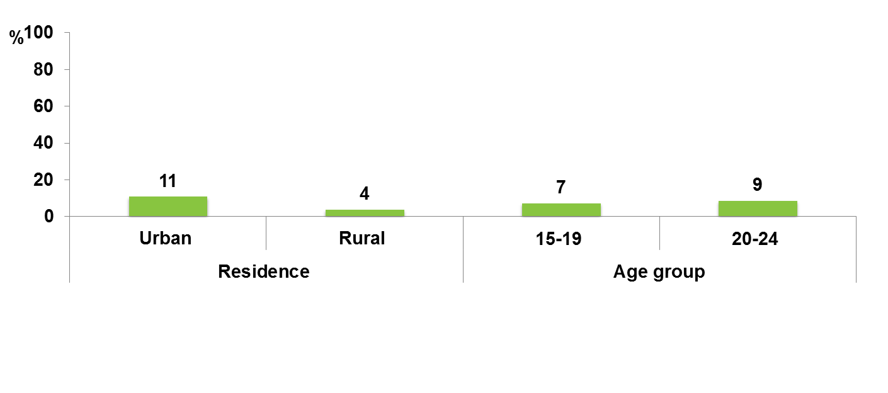
Proportion of young women (15-24 yr) with comprehensive HIV knowledge by residence and age group, 2009
Source: Prepared by www.aidsdatahub.org based on Central Bureau of Statistics DPR Korea, & UNICEF. (2010). Multiple Indicator Cluster Survey 2009 Final Report.

Slide 10
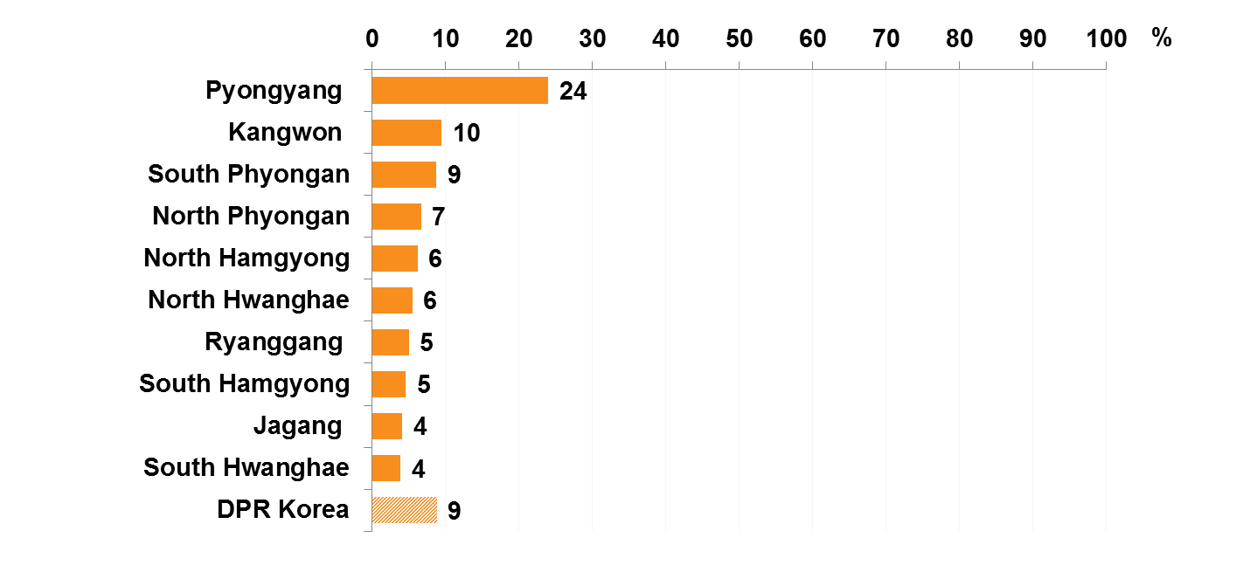
Proportion of women (15-49 yr) with comprehensive HIV knowledge by region, 2009
Source: Prepared by www.aidsdatahub.org based on Central Bureau of Statistics DPR Korea, & UNICEF. (2010). Multiple Indicator Cluster Survey 2009 Final Report.

Slide 11
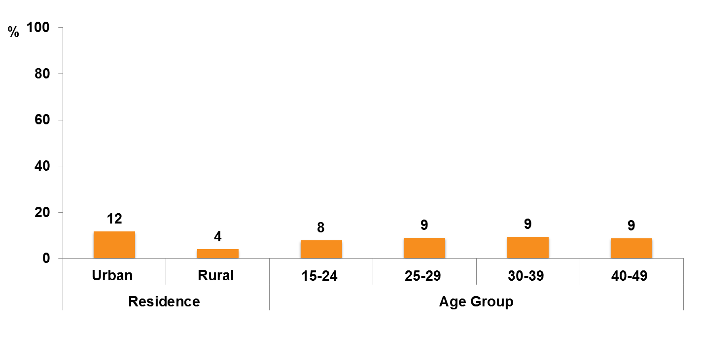
Proportion of women (15-49 yr) with comprehensive HIV knowledge by residence and age group, 2009
Source: Prepared by www.aidsdatahub.org based on Central Bureau of Statistics DPR Korea, & UNICEF. (2010). Multiple Indicator Cluster Survey 2009 Final Report.

Slide 12
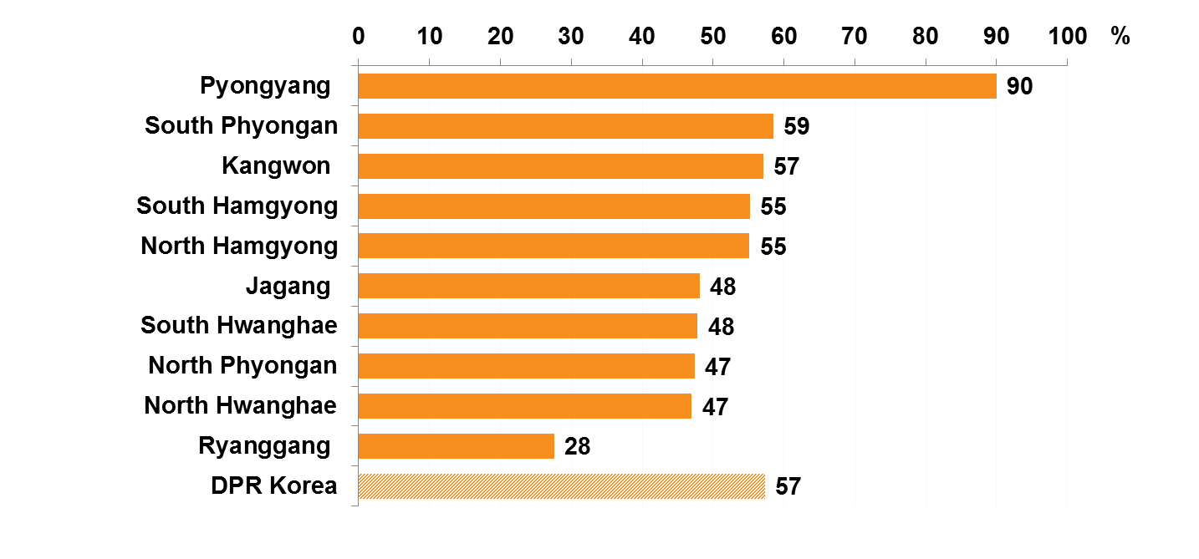
Proportion of women (15-49 yr) who know HIV can be transmitted from mother-to-child, by region, 2009
Source: Prepared by www.aidsdatahub.org based on Central Bureau of Statistics DPR Korea, & UNICEF. (2010). Multiple Indicator Cluster Survey 2009 Final Report.

Slide 13
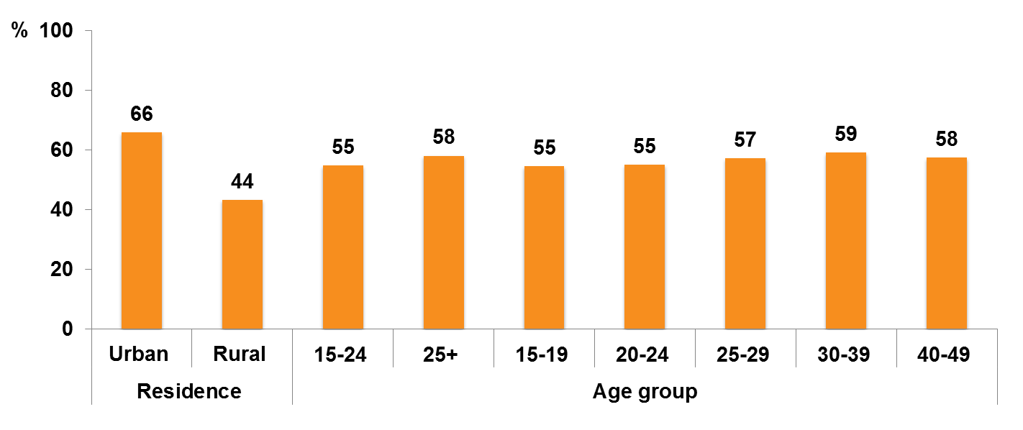
Proportion of women (15-49 yr) who know HIV can be transmitted from mother-to-child, by residence and age group, 2009
Source: Prepared by www.aidsdatahub.org based on Central Bureau of Statistics DPR Korea, & UNICEF. (2010). Multiple Indicator Cluster Survey 2009 Final Report.

Slide 14
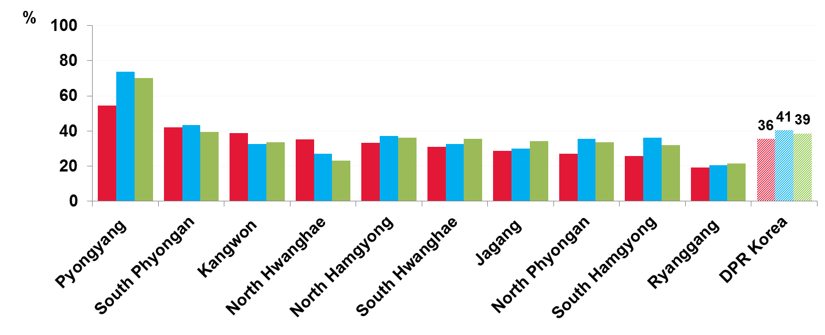
Proportion of women (15-49 yr) who know HIV can be transmitted from mother-to-child during pregnancy, delivery, or breastfeeding, by region, 2009
Source: Prepared by www.aidsdatahub.org based on Central Bureau of Statistics DPR Korea, & UNICEF. (2010). Multiple Indicator Cluster Survey 2009 Final Report.

Slide 15
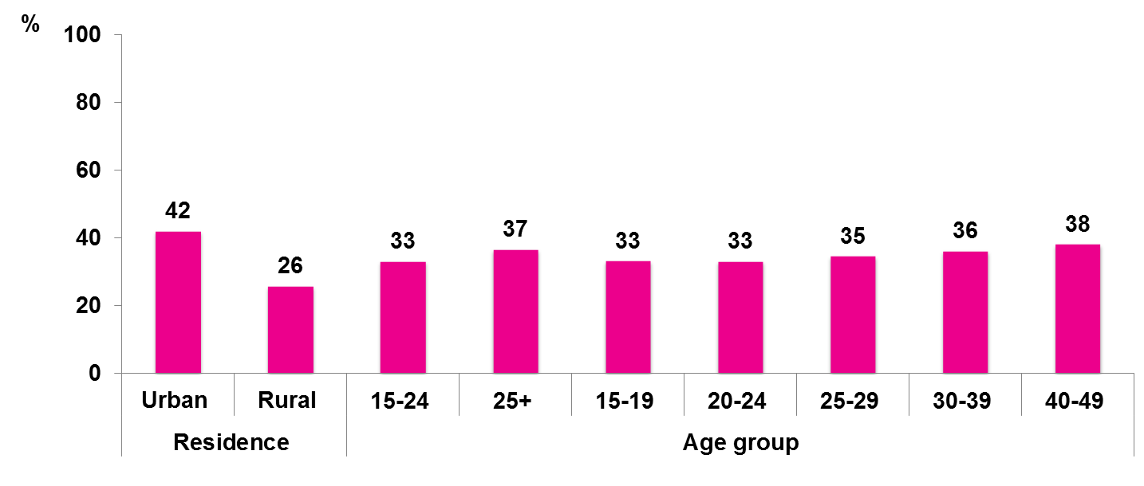
Proportion of women (15-49 yr) who know HIV can be transmitted from mother-to-child during pregnancy, by residence and age group, 2009
Source: Prepared by www.aidsdatahub.org based on Central Bureau of Statistics DPR Korea, & UNICEF. (2010). Multiple Indicator Cluster Survey 2009 Final Report.

Slide 16
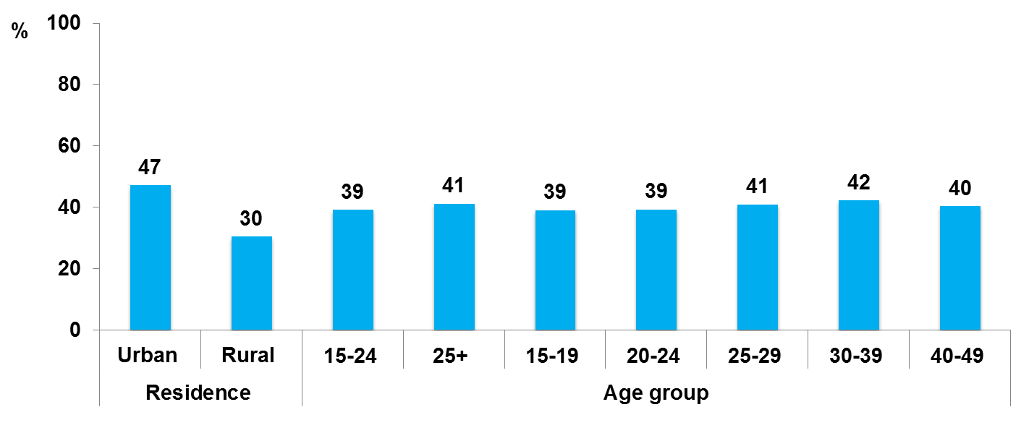
Proportion of women (15-49 yr) who know HIV can be transmitted from mother-to-child during delivery, by residence and age group, 2009
Source: Prepared by www.aidsdatahub.org based on Central Bureau of Statistics DPR Korea, & UNICEF. (2010). Multiple Indicator Cluster Survey 2009 Final Report.

Slide 17
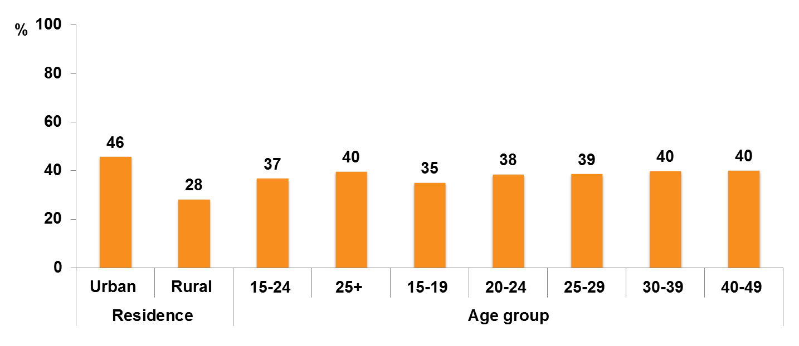
Proportion of women (15-49 yr) who know HIV can be transmitted from mother-to-child during breastfeeding, by residence and age group, 2009
Source: Prepared by www.aidsdatahub.org based on Central Bureau of Statistics DPR Korea, & UNICEF. (2010). Multiple Indicator Cluster Survey 2009 Final Report.

Slide 18
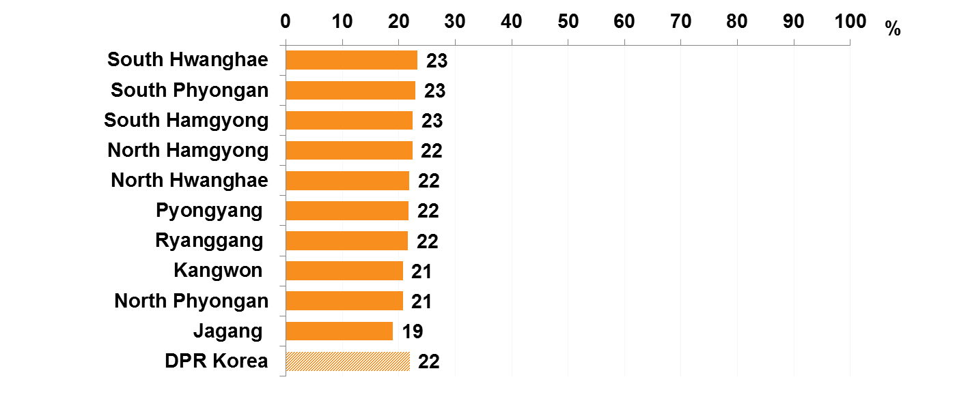
Proportion of women (15-49 yr) who would care for a family member with the AIDS virus in their own home, by region, 2009
Source: Prepared by www.aidsdatahub.org based on Central Bureau of Statistics DPR Korea, & UNICEF. (2010). Multiple Indicator Cluster Survey 2009 Final Report.

Slide 19
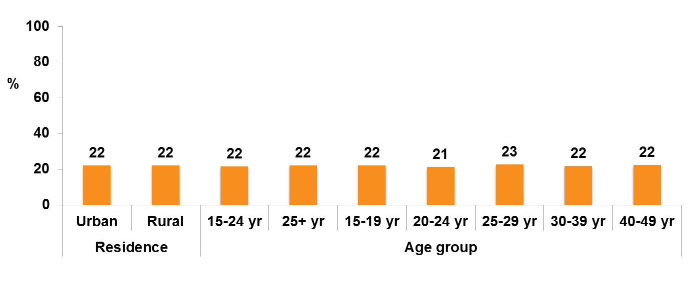
Proportion of women (15-49 yr) who would care for a family member with the AIDS virus in their own home, by residence and age group, 2009
Source: Prepared by www.aidsdatahub.org based on Central Bureau of Statistics DPR Korea, & UNICEF. (2010). Multiple Indicator Cluster Survey 2009 Final Report.

Slide 20
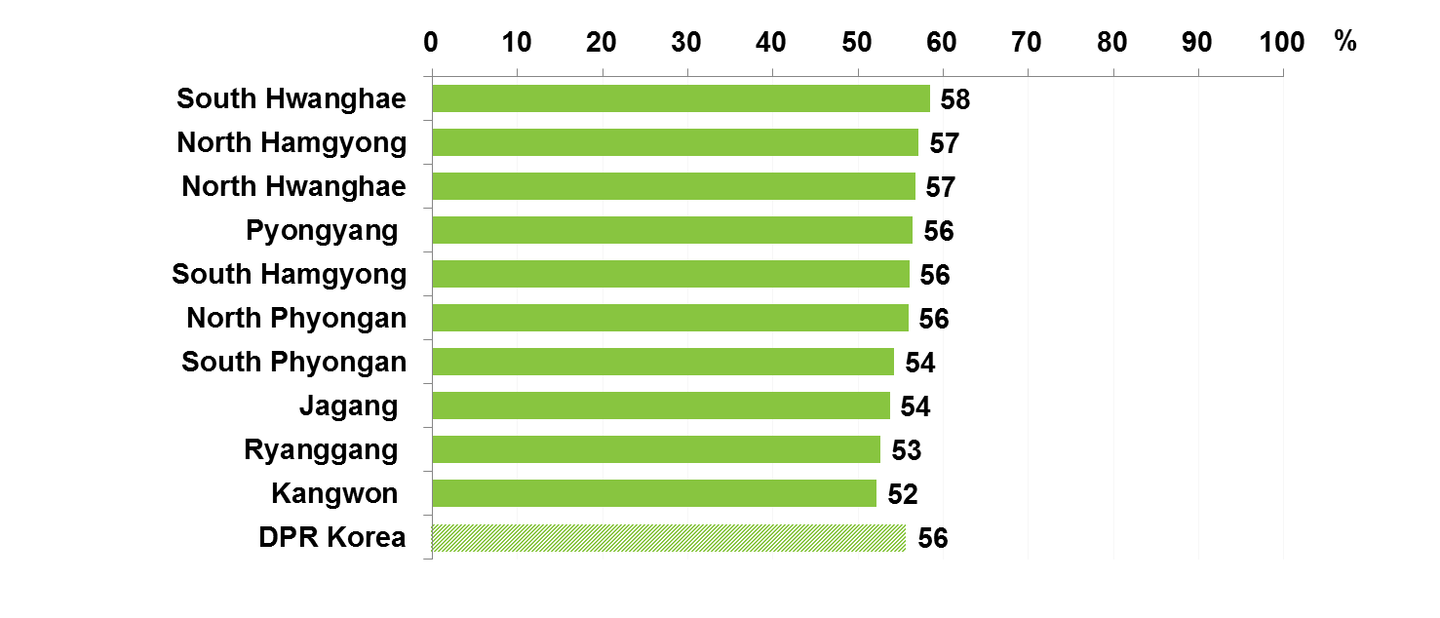
Proportion of women (15-49 yr) who would buy fresh vegetables from a shopkeeper or vendor who has the AIDS virus by region, 2009
Source: Prepared by www.aidsdatahub.org based on Central Bureau of Statistics DPR Korea, & UNICEF. (2010). Multiple Indicator Cluster Survey 2009 Final Report.

Slide 21
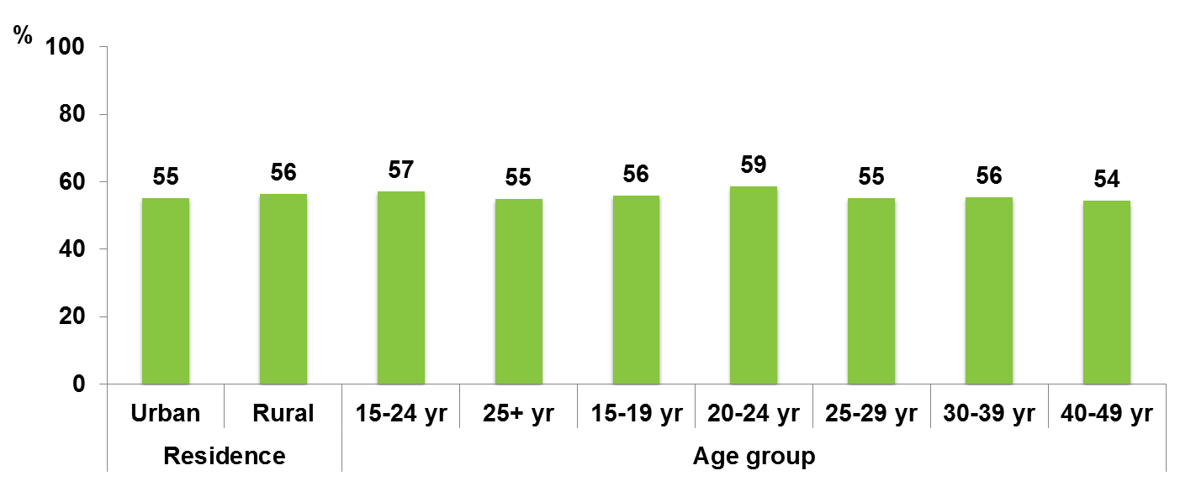
Proportion of women (15-49 yr) who would buy fresh vegetables from a shopkeeper or vendor who has the AIDS virus by residence and age group, 2009
Source: Prepared by www.aidsdatahub.org based on Central Bureau of Statistics DPR Korea, & UNICEF. (2010). Multiple Indicator Cluster Survey 2009 Final Report.

Slide 22
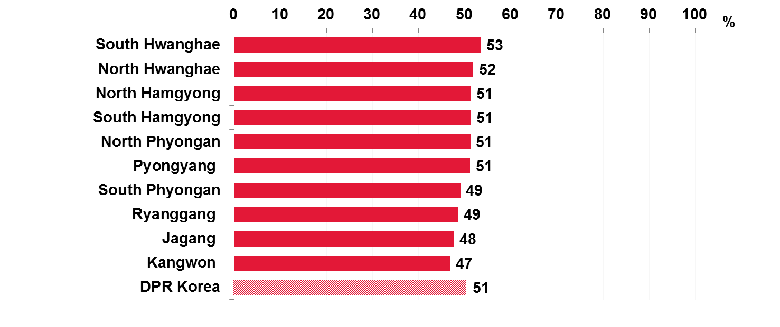
Proportion of women (15-49 yr) who believe that a female teacher with the AIDS virus and is not sick should be allowed to continue teaching, by region, 2009
Source: Prepared by www.aidsdatahub.org based on Central Bureau of Statistics DPR Korea, & UNICEF. (2010). Multiple Indicator Cluster Survey 2009 Final Report.

Slide 23
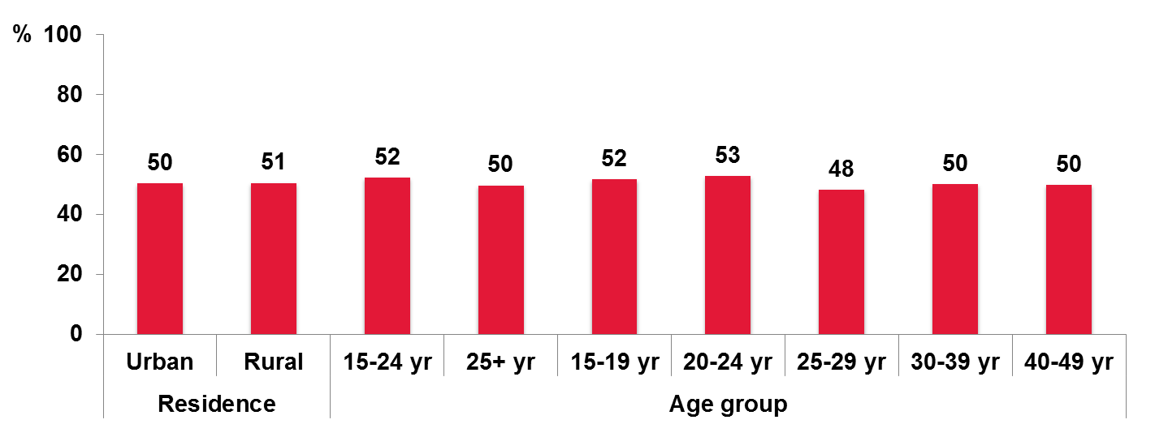
Proportion of women (15-49 yr) who believe that a female teacher with the AIDS virus and is not sick should be allowed to continue teaching, by residence and age group, 2009
Source: Prepared by www.aidsdatahub.org based on Central Bureau of Statistics DPR Korea, & UNICEF. (2010). Multiple Indicator Cluster Survey 2009 Final Report.

Slide 24
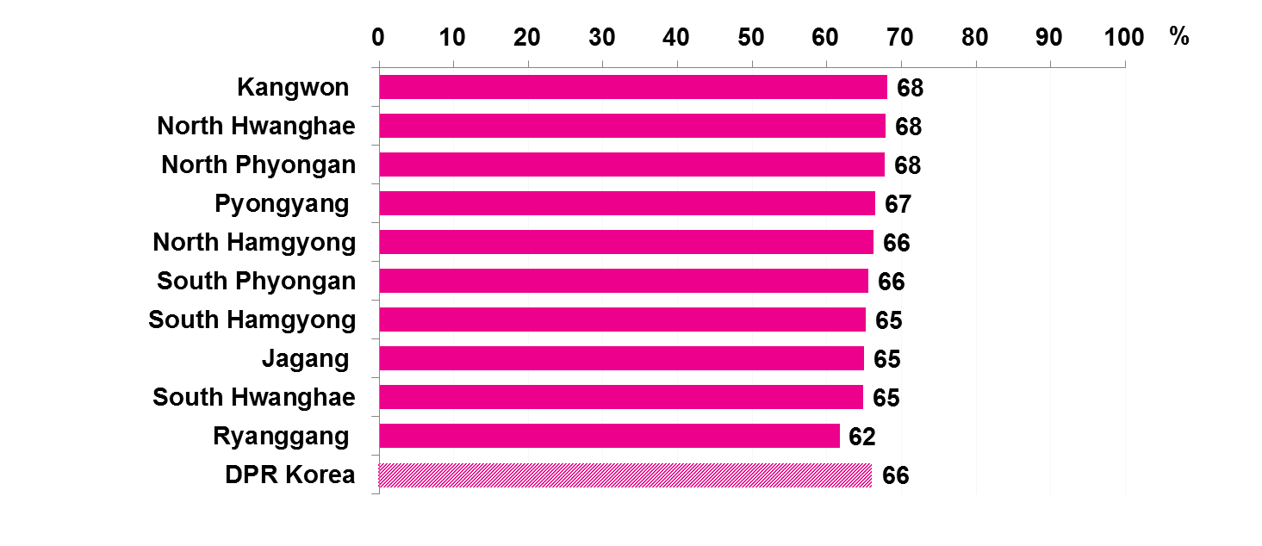
Proportion of women (15-49 yr) who would not want to keep secret that a family member is infected with the AIDS virus, by region, 2009
Source: Prepared by www.aidsdatahub.org based on Central Bureau of Statistics DPR Korea, & UNICEF. (2010). Multiple Indicator Cluster Survey 2009 Final Report.

Slide 25
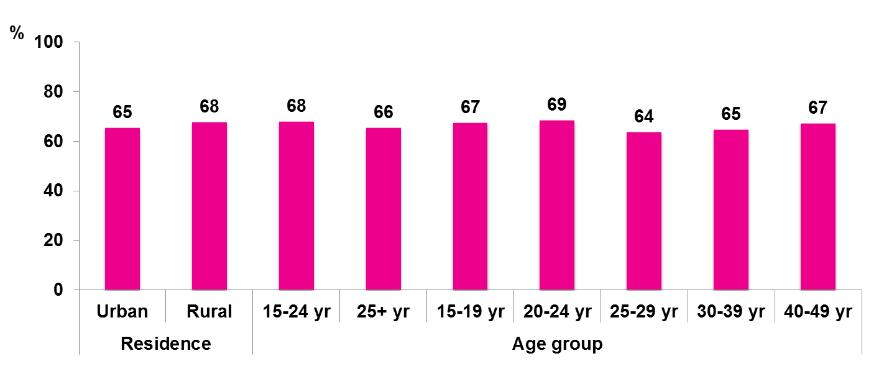
Proportion of women (15-49 yr) who would not want to keep secret that a family member is infected with the AIDS virus, by residence and age group, 2009
Source: Prepared by www.aidsdatahub.org based on Central Bureau of Statistics DPR Korea, & UNICEF. (2010). Multiple Indicator Cluster Survey 2009 Final Report.

Slide 26
HIV expenditure

Slide 27
THANK YOU
slides compiled by www.aidsdatahub.org
Data shown in this slide set are comprehensive to the extent they are available from country reports. Please inform us if you know of sources where more recent data can be used.
Please acknowledge www.aidsdatahub.org if slides are lifted directly from this site

Slide 28
National response

